Slide 1
1.02 Graphs of Linear Inequalities
Unit: Optimization

Slide 2
Important Parts of Linear Inequalities
Boundary Line: The linear equation that defines the edge of the inequality
Halfplane: The shaded region of the inequality
Test Point: A point on either side of the Boundary Line. Substitute the x and y values of this point in the original inequality. If you get a true statement, shade on the side of the Boundary Line that includes the test point. If you get a false statement, shade on the side of the Boundary Line that does not include the Test point.
Solution Set:
If $≤$ or $≥$ - corresponds to any ordered pairs on the boundary line or inside the halfplane
If $<$ or $>$ - corresponds to any ordered pairs inside the halfplane

Slide 3
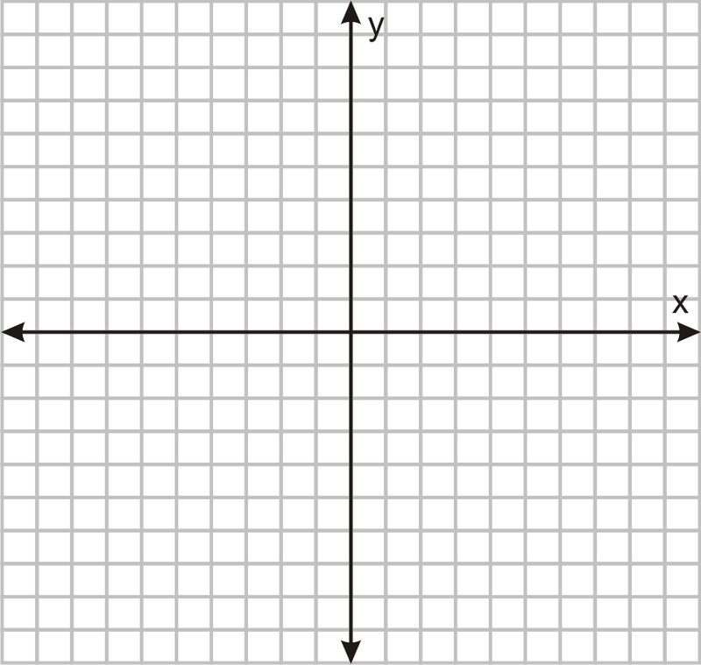
Graph the Line: $y<−\frac{2}{5}x+3$
$$a=\frac{RISE}{RUN}$$
RISE DOWN $2$
RUN RIGHT $5$
$$y=−\frac{2}{5}x+3$$
$$1$$
$$1$$

Slide 4
The Parts of the Line: $y<−\frac{2}{5}x+3$
$$y=−\frac{2}{5}x+3$$
$$1$$
Boundary Line
$$1$$
Halfplane
Solution Set

Slide 5
Graph the Line: $y≥3x−2$
$$a=\frac{RISE}{RUN}$$
RISE UP $3$
RUN RIGHT $1$
$$y=3x−2$$
$$1$$
$$1$$

Slide 6
Parts of the Line: $y≥3x−2$
Boundary Line
$$y=3x−2$$
Halfplane
$$1$$
$$1$$
Solution Set

Slide 7
Working With Inequalities
Practice

Slide 8
SoLve: $x+9≥3$

Slide 9
Finding the Rule of a Linear Inequality
From the graph

Slide 10
$$y≤\frac{6}{5}x+8$$
$$b=8$$
Line is increasing:
$a$ is positive
UP $6$
RIGHT $5$
$$a=\frac{6}{5}$$
$$y=\frac{6}{5}x+8$$
$$1$$
$$1$$

Slide 11
Practice
Visions
Page: 11 #2, 3, 8, 11

Slide 12
Day
2

Slide 13
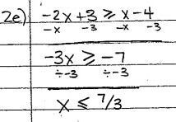
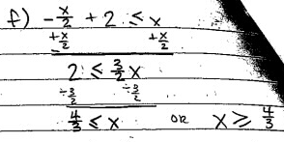
Page 11 #2

Slide 14
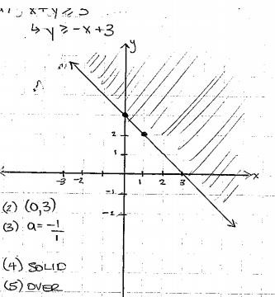
Page 11 #3a

Slide 15
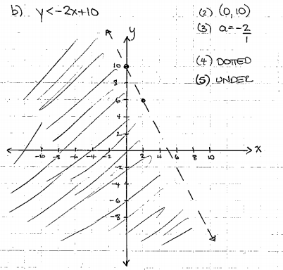
Page 11 #3b

Slide 16
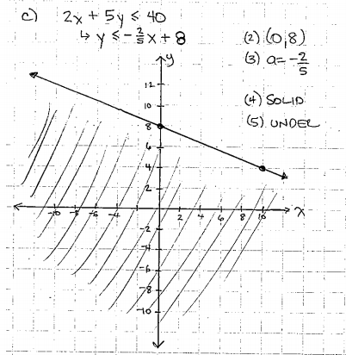
Page 11 #3C

Slide 17
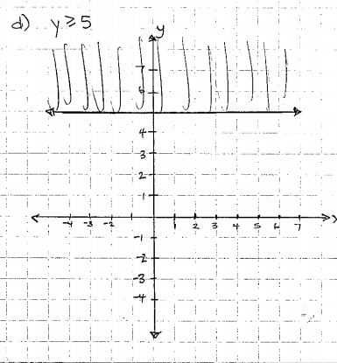
Page 11 #3D

Slide 18
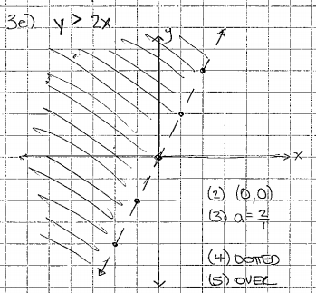
Page 11 #3E

Slide 19
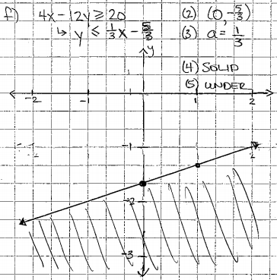
Page 11 #3E

Slide 20
Page 11 #3g

Slide 21
Page 11 #3H

Slide 22
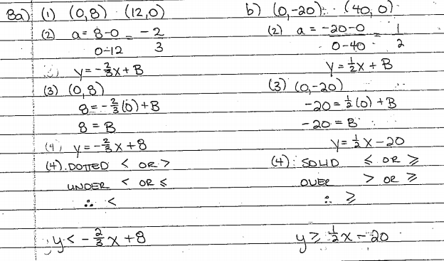
Page 11 # 8

Slide 23
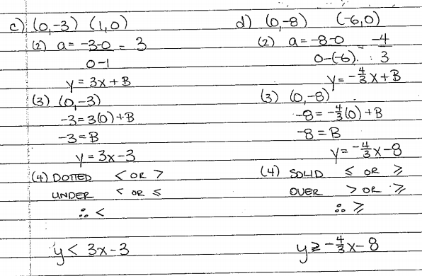
Page 11 # 8

Slide 24
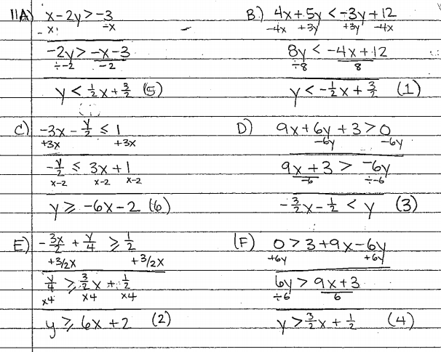
Page 11 # 11

Slide 25
Practice
Visions
Page: 12 #7, 9, 12

Slide 26
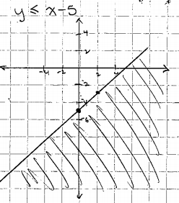
Page 11 # 7

Slide 27
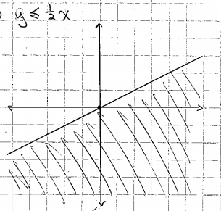
Page 11 # 7

Slide 28
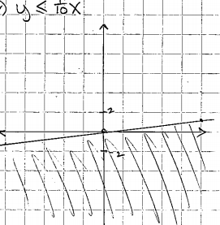
Page 11 # 7

Slide 29
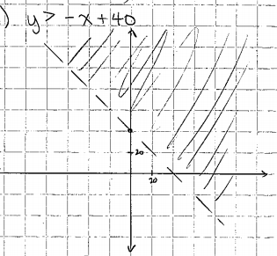
Page 11 # 7

Slide 30
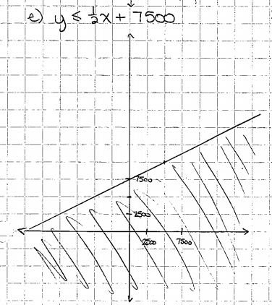
Page 11 # 7

Slide 31
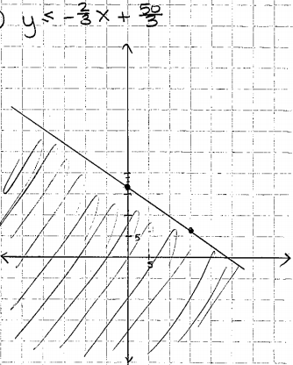
Page 11 # 7

Slide 32
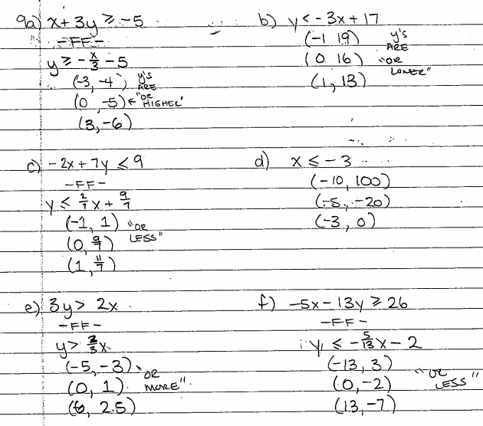
Page 11 #9

Slide 33
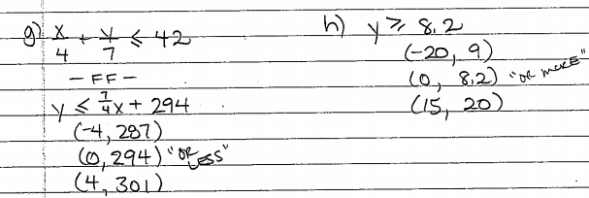
Page 11 #9

Slide 34
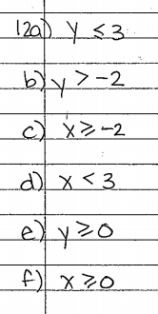
Page 11 #12

