Slide 1
1.03 Systems of Inequalities
Unit: Optimization

Slide 2
Systems of Inequalities
When solving a system of inequalities, you are looking for a SOLUTION SET that satisfies ALL linear inequalities involved.

Slide 3
Steps
Rearrange all rules into Function Form
Label the x and y-axis with the same scale
Graph the boundary lines for each inequality involved (Label as you go)
Shade the section of the Cartesian Plane that satisfies ALL linear inequalities involved.
Find the Points of Intersection (POIs) of the boundary lines around your solution set (using Comparison with the ax+b sections of each inequality).

Slide 4
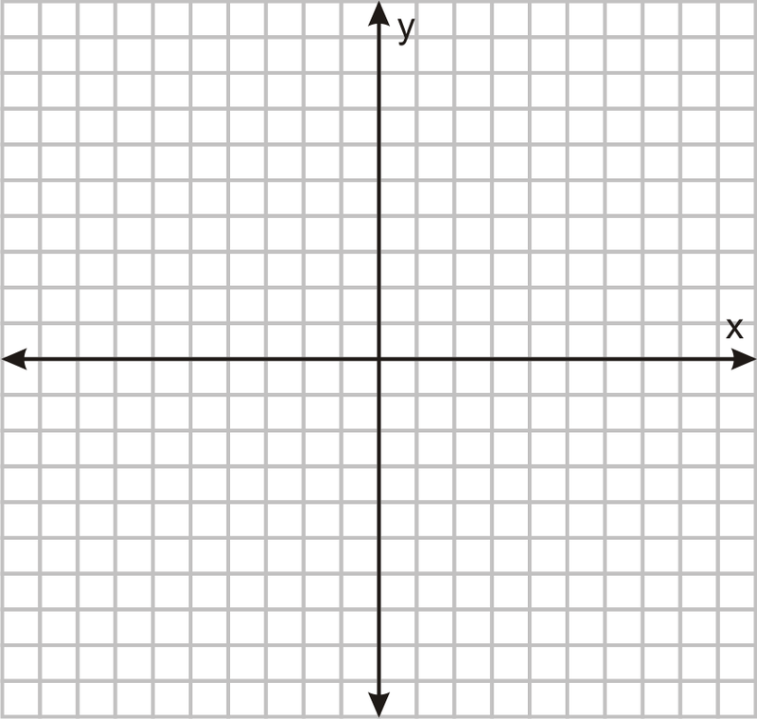
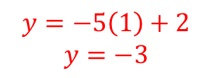

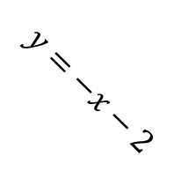
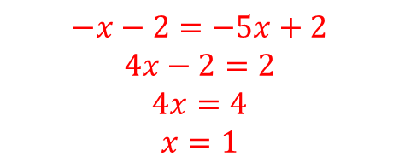
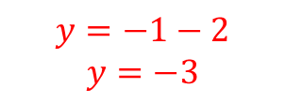
Solve the System
$$y=−x−2$$
$y≤−x−2$
$y≥ −5x+2$
$$1$$
Rearrange all rules into Function Form
Label the x and y-axis with the same scale
Graph the boundary lines for each inequality involved (Label as you go)
Shade the section of the Cartesian Plane that satisfies ALL linear inequalities involved.
Find all POIs of the boundary lines around your solution set.
$$1$$
DONE
DONE
DONE
$$y=−5x+2$$
POI:
DONE
$$−x−2=−5x+2$$
$$4x−2=2$$
$$4x=4$$
$$x=1$$
DONE
$$y=−1−2$$
$$y=−3$$
$$y=−5\left(1\right)+2$$
$$y=−3$$
$$(1,−3)$$

Slide 5
Is the POI Feasible?
Feasible: A possible point in the solution set
The POI is only feasible IF all boundary lines that cross through it are SOLID lines.
If even 1 boundary line is DOTTED … the point is NOT feasible.

Slide 6
Solve the System
$$y=−x−2$$
$y≤−x−2$
$y≥ −5x+2$
$$1$$
Rearrange all rules into Function Form
Label the x and y-axis with the same scale
Graph the boundary lines for each inequality involved (Label as you go)
Shade the section of the Cartesian Plane that satisfies ALL linear inequalities involved.
Find all POIs of the boundary lines around your solution set.
$$1$$
DONE
DONE
DONE
$$y=−5x+2$$
POI:
DONE
$$−x−2=−5x+2$$
$$4x−2=2$$
$$4x=4$$
$$x=1$$
DONE
$$y=−1−2$$
$$y=−3$$
$$y=−5\left(1\right)+2$$
$$y=−3$$
$$(1,−3)$$

Slide 7
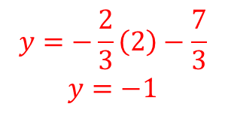
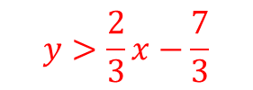




Solve the System
$$y=−3x+5$$
$3x+y≥5$
$2x−3y<7$
$$y≥−3x+5$$
$$y>\frac{2}{3}x−\frac{7}{3}$$
$$1$$
Rearrange all rules into Function Form
Label the x and y-axis with the same scale
Graph the boundary lines for each inequality involved (Label as you go)
Shade the section of the Cartesian Plane that satisfies ALL linear inequalities involved.
Find all POIs of the boundary lines around your solution set.
$$1$$
DONE
DONE
DONE
$$y=\frac{2}{3}x−\frac{7}{3}$$
POI:
DONE
$$−3x+5=\frac{2}{3}x−\frac{7}{3}$$
$$−\frac{11}{3}x=−\frac{22}{3}$$
$$x=2$$
DONE
POI not feasible
$$y=−3\left(2\right)+5$$
$$y=−1$$
$$y=−\frac{2}{3}\left(2\right)−\frac{7}{3}$$
$$y=−1$$
$$(2,−1)$$

Slide 8
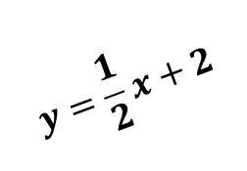
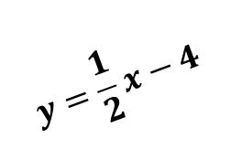

Special Cases
$$y=\frac{1}{2}x+2$$
Parallel Lines
$y≤\frac{1}{2}x+2$ $y>\frac{1}{2}x−4$
$$1$$
$$1$$
$$y=\frac{1}{2}x−4$$

Slide 9
Special Cases
$$y=\frac{1}{2}x+2$$
Parallel Lines
$y≤\frac{1}{2}x+2$ $y>\frac{1}{2}x−4$
$$1$$
$$1$$
$$y=\frac{1}{2}x−4$$

Slide 10

Special Cases
$$y=\frac{1}{2}x+2$$
Parallel Lines
$y≤\frac{1}{2}x+2$ $y<\frac{1}{2}x−4$
$$1$$
$$1$$
$$y=\frac{1}{2}x−4$$

Slide 11
Special Cases
$$y=\frac{1}{2}x+2$$
Parallel Lines
$y≤\frac{1}{2}x+2$ $y<\frac{1}{2}x−4$
$$1$$
$$1$$
$$y=\frac{1}{2}x−4$$

Slide 12

Special Cases
$$y=\frac{1}{2}x+2$$
Parallel Lines
$y≥\frac{1}{2}x+2$ $y>\frac{1}{2}x−4$
$$1$$
$$1$$
$$y=\frac{1}{2}x−4$$

Slide 13
Special Cases
$$y=\frac{1}{2}x+2$$
Parallel Lines
$y≥\frac{1}{2}x+2$ $y>\frac{1}{2}x−4$
$$1$$
$$1$$
$$y=\frac{1}{2}x−4$$

Slide 14

Special Cases
$$y=\frac{1}{2}x+2$$
Parallel Lines
$y≥\frac{1}{2}x+2$ $y<\frac{1}{2}x−4$
$$1$$
$$1$$
$$y=\frac{1}{2}x−4$$
No Solution Set

Slide 15
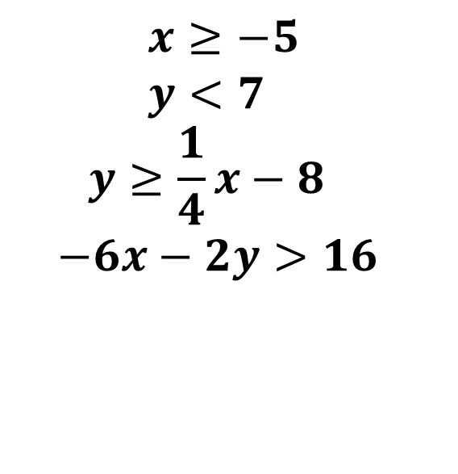
Solve the System
$$x≥−5$$
$$y<7$$
$$y≥\frac{1}{4}x−8$$
$$−6x−2y>16$$
$$1$$
$$1$$

