Slide 1
1.04 Words to Inequations
Unit: Optimization

Slide 2
Before you Begin
Create 2 tables for key words:
Addition | Subtraction
Multiplication | Division
Less Than | Greater Than
Less Than or Equal to | Greater Than or Equal to

Slide 3
Step 1
Read through the ENTIRE problem, highlighting (or making note of) ‘MATH’ words as you go

Slide 4
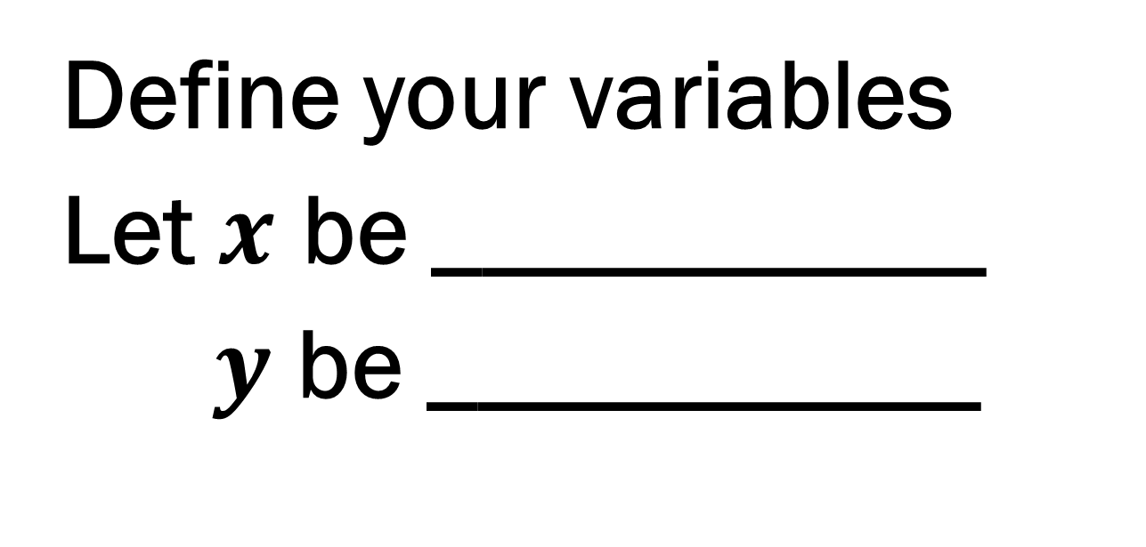
Step 2
Define your variables
Let $x$ be ___________
$y$ be ___________

Slide 5
Step 3: Follow the Chart
Sometimes that inequation is a direct translation of the words you read. (Ex6)

Slide 6
Example 1:
A number is more than another number
$x$ and $y$ are numbers
$$x>y$$
Back to FlowChart

Slide 7
Example 2:
A pencil case contains only pens and pencils. There is a maximum of 10 items in the pencil case.
$x$ is number of pens and $y$ is number of pencils
$$x+y≤10$$
Back to FlowChart

Slide 8
Example 3:
A truck weighs at least twice as much as a car.
$x$ is weight of truck and $y$ is weight of car
$$x≥2y$$
Back to FlowChart

Slide 9
Example 4:
Jim collects stamps. There are most 2 more domestic stamps than international stamps.
$x$ is # of domestic stamps and $y$ is # of international stamps
$$x≤y+2$$
Back to FlowChart

Slide 10
Example 5:
In my pocket there are nickels and dimes. I have less than 30 coins.
$x$ is # nickels and $y$ is # of dimes
$$x+y<30$$
There is up to $1.90
$$0.05x+0.1y≤1.90$$
Back to FlowChart

Slide 11
Example 6:
A municipal garden grows red tulips and white tulips. The number of white tulips increased by 500 is greater than twice the number of red tulips
$x$ is # red tulips and $y$ is # white tulips
$$y+500>2x$$
Back to FlowChart

