Slide 1
1.05 Polygon of Constraints
Unit: Optimization

Slide 2
Brainstorm: What does it mean?
POLYGON
CONSTRAINTS
$$of$$

Slide 3
Systems to Polygon of Constraints
We have been studying Systems of Inequalities.
You needed to know the difference:
Graphing vs Solving
You have encountered two types of Systems:
Unbounded
Bounded

Slide 4
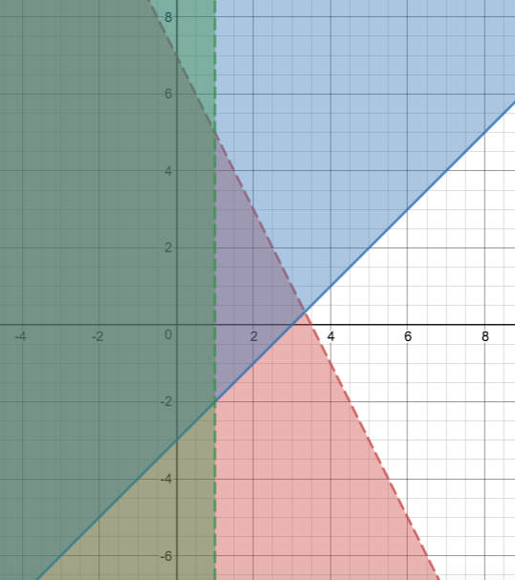

Unbounded
$$y≥x−3$$
$$y<−2x+7$$
$$y≥x−3$$
$$x<1$$
The shading would continue on forever to the left
This is NOT a Polygon of Constraints
$$x<1$$
$$y<−2x+7$$

Slide 5
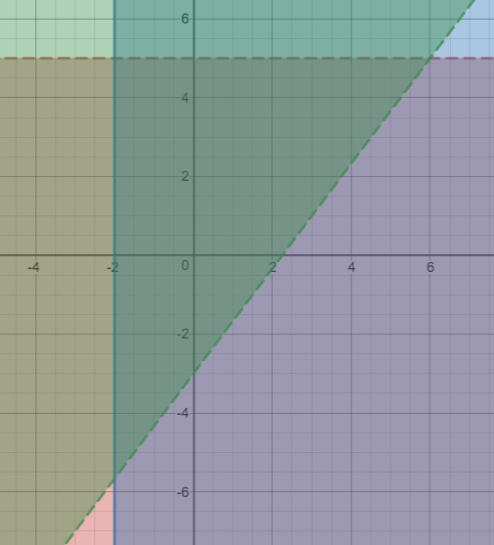
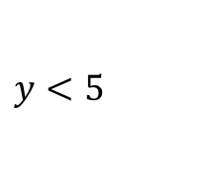

bounded
$y>\frac{4}{3}x−3$
$y<5$
$y<5$
$x≥−2$
$y>\frac{4}{3}x−3$
The shading is contained to a specific region by the inequalities
This IS a Polygon of Constraints
$x≥−2$

Slide 6
Polygon of Constraints: Process
Words to Rules
SOLVE the System
Graph the boundary lines of the inequalities
Shade the solution set
Solve the Vertices (Points of Intersection of the Polygon)

Slide 7
The Purpose
To find all the possible solutions (points) that would be feasible for a situation that involves boundaries.
Best understood if explored with the real life question.

Slide 8
Pet-Care
Sandra and Jane want to open a pet spa. They will offer two services: PET BATHS and PET-iCURES
They have conducted market research and found the following:
A PET BATH takes 2 hours and a PET-iCURE takes 1 hour
They will never do a negative amount of PET BATHS
They are guaranteed to do at least 2 PET-iCURES a day
They plan on opening their store for 8 hours a day
They charge $40 per PET BATHS and $10 per PET-iCURES

Slide 9
Polygon Process
$$x=PET−iCURES$$
$$y=PET BATHS$$
Words to Rules
A PET BATH takes 2 hours and a PET-iCURE takes 1 hour
They will never do a negative amount of PET BATHS
They are guaranteed to do at least 2 PET-iCURES a day
They plan on opening their store for 8 hours a day
They charge $40 per PET BATHS and $10 per PET-iCURES

Slide 10
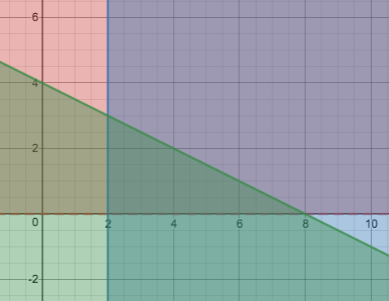

Polygon Process
Words to Rules $y>0$ $x≥2$ $x+2y≤8$
SOLVE the System
Graph the boundary lines of the inequalities
Shade the solution set
Solve the Vertices (POIs of the Polygon)
$$y>0$$
$$x+2y≤8$$
$$x≥2$$

Slide 11
Context Questions
Can you give partial Baths/Pet-icures and still get paid?
What are all the possible combinations of PET-iCURES and BATHS they could give in a day?
$$x=PET−iCURES$$
$$y=PET BATHS$$
$$\left(2,0\right)$$
$$\left(6,0\right)$$
$$\left(3,1\right)$$
$$\left(2,2\right)$$
$$\left(3,0\right)$$
$$\left(7,0\right)$$
$$\left(4,1\right)$$
$$\left(3,2\right)$$
$$\left(4,0\right)$$
$$\left(8,0\right)$$
$$\left(5,1\right)$$
$$\left(4,2\right)$$
$$\left(5,0\right)$$
$$\left(2,1\right)$$
$$\left(6,1\right)$$
$$\left(2,3\right)$$

Slide 12
The last Rule
They charge $40 per PET BATHS and $10 per PET-iCURES
$$40y+10x=REVENUE$$
Find all the possible revenues the girls could make
$$\left(2,0\right)$$
$$\left(6,0\right)$$
$$\left(3,1\right)$$
$$\left(2,2\right)$$
$$\$20$$
$$\$60$$
$$\$70$$
$$\$100$$
$$\left(3,0\right)$$
$$\left(7,0\right)$$
$$\left(4,1\right)$$
$$\left(3,2\right)$$
$$\$30$$
$$\$70$$
$$\$80$$
$$\$110$$
$$\left(4,0\right)$$
$$\left(8,0\right)$$
$$\left(5,1\right)$$
$$\left(4,2\right)$$
$$\$40$$
$$\$80$$
$$\$90$$
$$\$120$$
$$\left(5,0\right)$$
$$\left(2,1\right)$$
$$\left(6,1\right)$$
$$\left(2,3\right)$$
$$\$50$$
$$\$60$$
$$\$100$$
$$\$140$$

Slide 13
Notice
The Best options are the vertices!
Are our vertices Feasible?

Slide 14
Purpose
To find all the possible solutions (points) that would be feasible for a situation that involves boundaries.

