Slide 1
1.06 Target Objective & Optimizing Function
Unit: Optimization

Slide 2
Brainstorm: What does it mean?
TARGET
OBJECTIVE

Slide 3
Polygon of Constraints: The Purpose
To find all the possible solutions (points) that would be feasible for a situation that involves boundaries.
The reason you create a Polygon of Constraints is to test for your Target Objective. It is the GOAL of the entire process.
Target Objective: The Goal

Slide 4
Target Objective
Always to MAXIMIZE or MINIMIZE something:
Revenue
Sales
Costs
Profits
Attendance
etc…

Slide 5
Pet-Care
Sandra and Jane want to open a pet spa. They will offer two services: PET BATHS and PET-iCURES
They have conducted market research and found the following:
A PET BATH takes 2 hours and a PET-iCURE takes 1 hour
They will never do a negative amount of PET BATHS
They are guaranteed to do at least 2 PET-iCURES a day
They plan on opening their store for 8 hours a day
They charge $40 per PET BATHS and $10 per PET-iCURES
TARGET: to maximize revenue

Slide 6
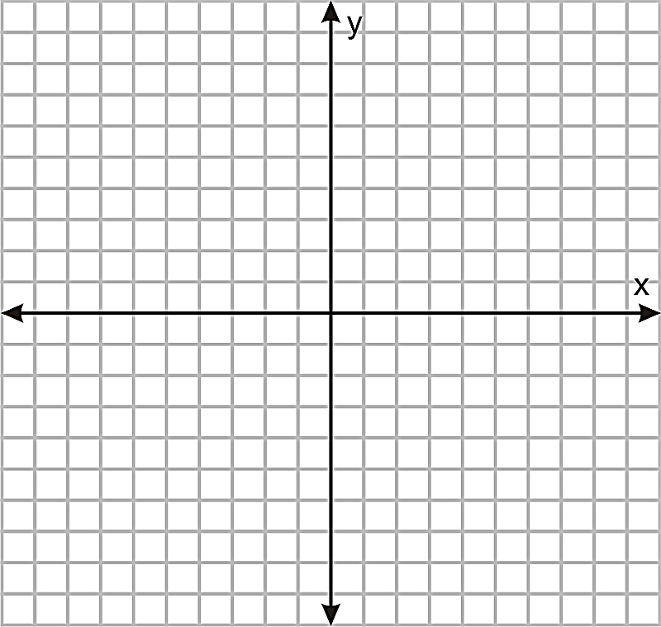

Polygon Process
Words to Rules $y>0$ $x≥2$ $x+2y≤8 →y≤−\frac{1}{2}x+4$
SOLVE the System
Graph the boundary lines of the inequalities
Shade the solution set
Solve the Vertices (POIs of the Polygon)
$$y≤−\frac{1}{2}x+4$$
A(2, 3)
B(8, 0)
$$1$$
$$1$$
C(2, 0)
$$y>0$$
$$\left(2,0\right)$$
$$\left(6,0\right)$$
$$\left(3,1\right)$$
$$\left(2,2\right)$$
$$\$20$$
$$\$60$$
$$\$70$$
$$\$60$$
Target:
Revenue information was given
MAX revenue is goal
$$x≥2$$
$$\left(3,0\right)$$
$$\left(7,0\right)$$
$$\left(4,1\right)$$
$$\left(3,2\right)$$
$$\$30$$
$$\$70$$
$$\$80$$
$$\$70$$
$$\left(4,0\right)$$
$$\left(8,0\right)$$
$$\left(5,1\right)$$
$$\left(4,2\right)$$
$$\$40$$
$$\$80$$
$$\$90$$
$$\$80$$
$$\left(5,0\right)$$
$$\left(2,1\right)$$
$$\left(6,1\right)$$
$$\left(2,3\right)$$
$$\$50$$
$$\$60$$
$$\$100$$
$$\$140$$

Slide 7
Optimizing Function
The Function (RULE) that calculates the target objective.
When you read the paragraph of information, it is generally the only statement that cannot be made into an inequality.

Slide 8
Pet Care Example: The last Rule
They charge $40 per PET BATHS and $10 per PET-iCURES
$$40y+10x=REVENUE$$
Since our target objective was to maximize revenue, the optimizing function will calculate revenue.

Slide 9
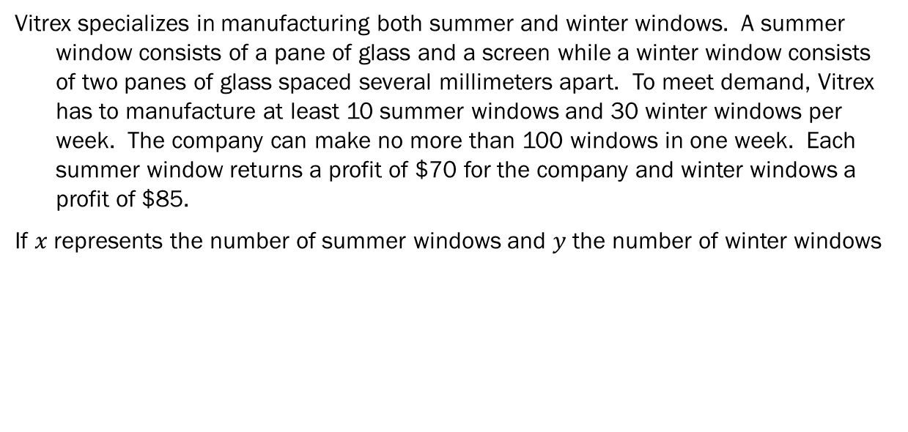
Onwards and Upwards
Vitrex specializes in manufacturing both summer and winter windows. A summer window consists of a pane of glass and a screen while a winter window consists of two panes of glass spaced several millimeters apart. To meet demand, Vitrex has to manufacture at least 10 summer windows and 30 winter windows per week. The company can make no more than 100 windows in one week. Each summer window returns a profit of $70 for the company and winter windows a profit of $85.
If $x$ represents the number of summer windows and $y$ the number of winter windows

Slide 10
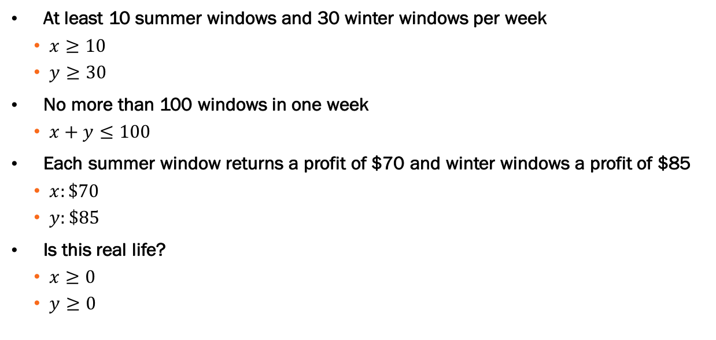
Onwards and Upwards
At least 10 summer windows and 30 winter windows per week
$x≥10$
$y≥30$
No more than 100 windows in one week
$x+y≤100$
Each summer window returns a profit of $70 and winter windows a profit of $85
$x:\$70$
$y:\$85$
Is this real life?
$x≥0$
$y≥0$

Slide 12
Does a weekly output of 25 summer windows and 65 winter windows satisfy the production constraints? Justify?
TEST:
$25≥10?$
$65≥30?$
$65≤−25+100?$
YES, it’s in the shaded region

Slide 13
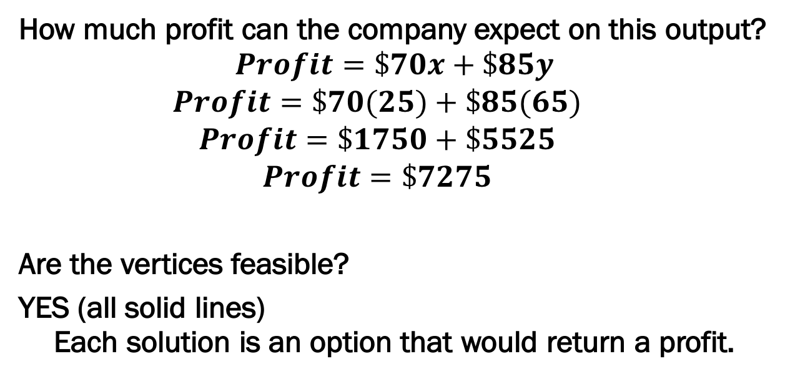
How much profit can the company expect on this output? $$Profit=\$70x+\$85y$$
$$Profit=\$70(25)+\$85(65)$$
$$Profit=\$1750+\$5525$$
$$Profit=\$7275$$
Are the vertices feasible?
YES (all solid lines) Each solution is an option that would return a profit.

Slide 14
What rule gives us the profit $P(x)$ for $x$ number of summer windows and $y$ number of winter windows? $$P\left(x\right)=70x+85y$$
Do they want a maximum or minimum? $$\max{}$$

Slide 15
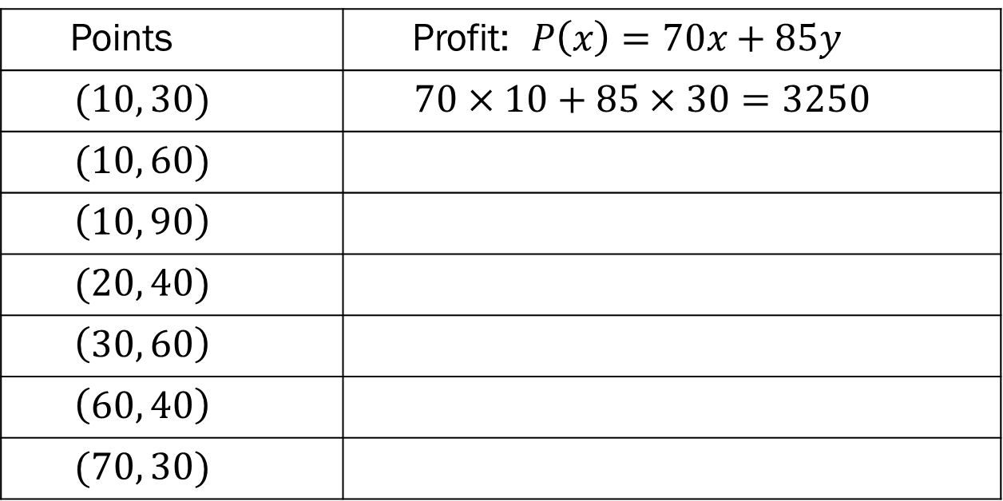
Points | Profit: $P\left(x\right)=70x+85y$
$$(10, 30)$$ | $$70×10+85×30=3250$$
$$(10, 60)$$
$$\left(10, 90\right)$$
$$(20, 40)$$
$$\left(30, 60\right)$$
$$\left(60, 40\right)$$
$$(70, 30)$$

Slide 16
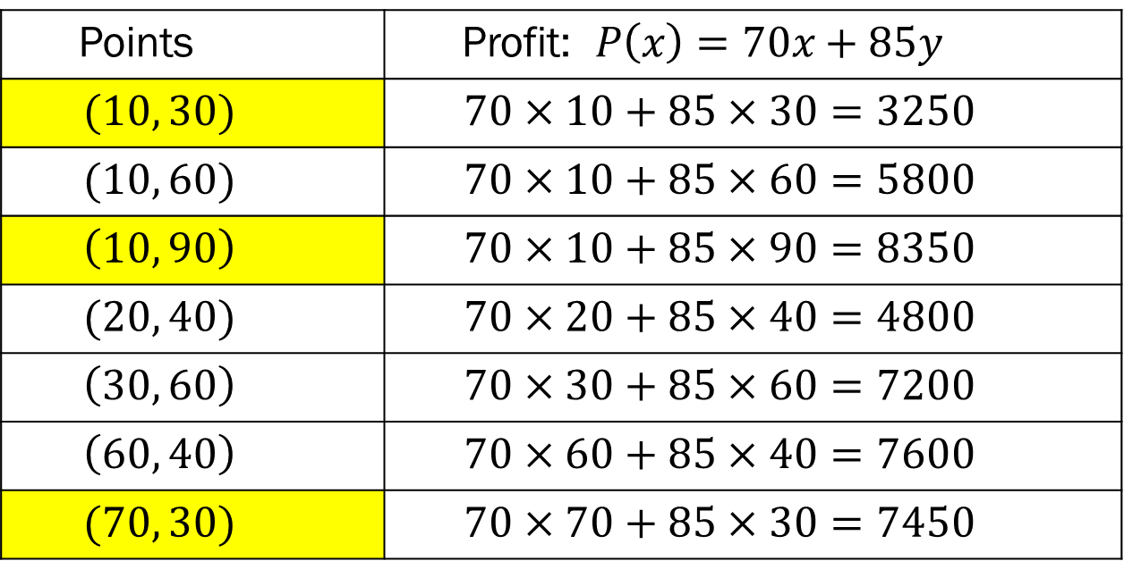
Points | Profit: $P\left(x\right)=70x+85y$
$$(10, 30)$$ | $$70×10+85×30=3250$$
$$(10, 60)$$ | $$70×10+85×60=5800$$
$$\left(10, 90\right)$$ | $$70×10+85×90=8350$$
$$(20, 40)$$ | $$70×20+85×40=4800$$
$$\left(30, 60\right)$$ | $$70×30+85×60=7200$$
$$\left(60, 40\right)$$ | $$70×60+85×40=7600$$
$$(70, 30)$$ | $$70×70+85×30=7450$$

Slide 17
Of the preceding pairs, which returns the highest profit? $$(10, 90)$$
How many windows of each type must Vitrex manufacture to generate the highest profit? $$10−summer and 90−winter$$

