Slide 1
Current Intensity and Voltage

Slide 2
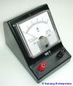
5.4 Current Intensity
Symbol: I
Units: Amperes, A
Write this in your notebook.
Current: the amount of electrons that flow through a wire
Example: 0.7 amperes is shown by
I = 0.7 A
An ammeter is the instrument used to measure current intensity. It has to be placed where the charge passes!
A

Slide 3
Current Intensity
Write this in your notebook.
The current intensity in a circuit can be determined using the formula:
I = q
∆t
I is the current intensity in amps (A)
q is the charge in coulombs (C)
t is time in seconds (s)

Slide 4
Ex #1
Write this in your notebook.
What is the current flowing through a car headlight if there are 900 C of charge used in 1 minute?
I = q
Δt
= 900 C
60 s
I = 15 A

Slide 5
Ex #2:
Write this in your notebook.
How much charge does it take to operate an MP3 player for 15 minutes if the current is 2A?
I = q
Δt

Slide 6
Ex #3:
Write this in your notebook.
A car headlight uses 6A. How long would it shine if it received a charge of 900 C?
I = q
Δt

Slide 7
5.5 Potential Difference (Voltage)
Symbol: V
Units: Volts, V
Write this in your notebook.
Potential Difference what causes the electrons to flow through the wire. (kind of like “water pressure”)
Provided by a battery or power supply
Example: V = 12V
A voltmeter is used to measure potential difference
V

Slide 8
Potential Difference (Voltage)
Write this in your notebook.
The potential difference in a circuit can be determined using the formula:
V=E
q
V is potential difference in volts (V)
E is the energy in joules (J)
q is the electric charge in coulombs (C)

Slide 9
Ex #1
Write this in your notebook.
In a house, how much energy is provided by 120V service providing 200C of charge?
V=E
q

Slide 10
5.6 Resistance
Write this in your notebook.
Resistance is how difficult it is for current to flow
Resistance is the opposite of conductance!
A resistor is used to slow current down and convert electrical energy into heat energy (e.g. light bulb, stove element).
Symbol: R
Units: Ohms, Ω

Slide 11
5.7 Ohm’s Law
Write this in your notebook.
This formula shows the relationship between Resistance (R), current intensity (I) and potential difference (V).
V = RI
# of ohms (Ω)
# of amps (A)

Slide 12
Summary Table
 | Resistance | Current | Potential Difference
Definition | Ability to slow current down | Is a measurement of the flow of electrons | Pushing the electrons thru the wires
Symbol | R | I | V
Units | Ohms (Ω) | Amps (A) | Volts (V)
Formula (if applicable) | V= RI | I = q ∆t | V = E q
How is it measured (if applicable) | calculated | Ammeter or calculated | Voltmeter or calculated

Slide 13
Class Work
P172 Textbook
#1, 2, 3
#4
#7, 8
#10
#12
#13, 16

Slide 14
Stop here

Slide 15
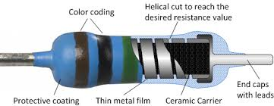
Colour coding on resistors
Resistors are coated with ceramic.
They have colour coded bands to indicate the resistance strength!

Slide 16
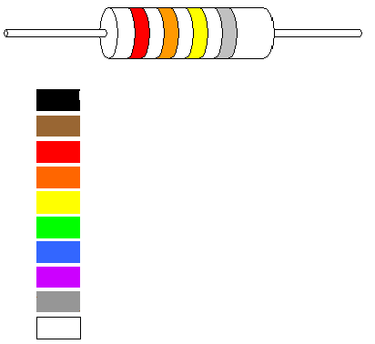
Resistor
2nd
3rd
1st
Black 0
Brown 1
Red 2
Orange 3
Yellow 4
Green 5
Blue 6
Violet 7
Gray 8
White 9
1st colour = 1st #
2nd colour = 2nd #
3rd colour = # of zeros
0 000 Ω
2
3

