Slide 1
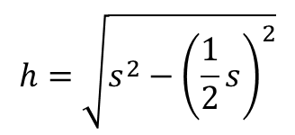
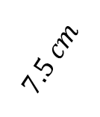
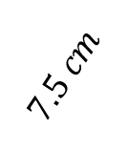
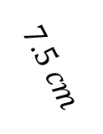
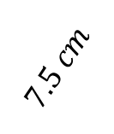
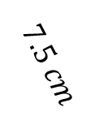
Equilateral Triangles
EQUILATERAL TRIANGLE
CUT TRIANGLE IN HALF
PYTHAGOREAN THEOREM $c^{2}=a^{2}+b^{2}$
$$7.5 cm$$
$$7.5 cm$$
$$7.5 cm$$
$$7.5 cm$$
$$7.5 cm$$
$$7.5 cm$$
$$7.5 cm$$
$$3.75 cm$$
$$h=\sqrt{s^{2}−{\left(\frac{1}{2}s\right)}^{2}}$$

Slide 2
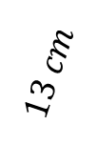
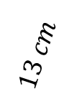
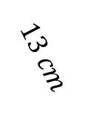
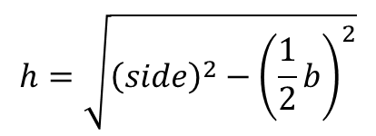
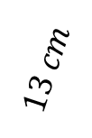
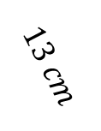
Isosceles Triangles
ISOSCELES TRIANGLE
CUT TRIANGLE IN HALF
PYTHAGOREAN THEOREM $c^{2}=a^{2}+b^{2}$
$$13 cm$$
$$13 cm$$
$$13 cm$$
$$5 cm$$
$$13 cm$$
$$13 cm$$
$$5 cm$$
$$5 cm$$
$$2.5 cm$$
$$h=\sqrt{{\left(side\right)}^{2}−{\left(\frac{1}{2}b\right)}^{2}}$$

Slide 3
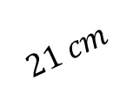
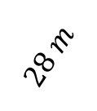
Try It
(1)
(2)
$$21 cm$$
$$28 m$$
$$52 cm$$

Slide 4
Finding Apothem
The –”agons” (pent-, hex-, hept-, oct- …)
Side Length
FORMULA
$$Apothem =\frac{side length÷2}{\tan\left(\left(360÷\# of sides\right)÷2\right)}$$
STEPS
Divide the side length by 2
Divide 360 by the number of sides
Divide the value found in step two by 2
Plug into the formula

Slide 5

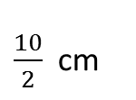

Where the Formula Comes From
The –”agons” (pent-, hex-, hept-, oct- …)
PENT-agon
$$5 sides=5 isosceles triangles$$
The interior angles:
-- 5 sections made of 360$°$
$$360÷5=72$$
Cut Triangle in half
10 cm
$${\left(\frac{72}{2}\right)}^{°}$$
x
apothem
$\frac{10}{2}$ cm
$$72°$$
Trigonometry for RIGHT Triangles:
SOH CAH TOA
TANGENT:
$$\tan{θ}=\frac{opposite}{adjacent}$$
$$\tan{36}=\frac{5}{apothem}$$
$$\left(apothem\right)\left(\tan{36}\right)=5$$
$$apothem=\frac{5}{\tan{36}}$$
$$apothem≈6.8819 cm$$
apothem
x
x
10 cm

Slide 6
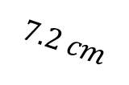
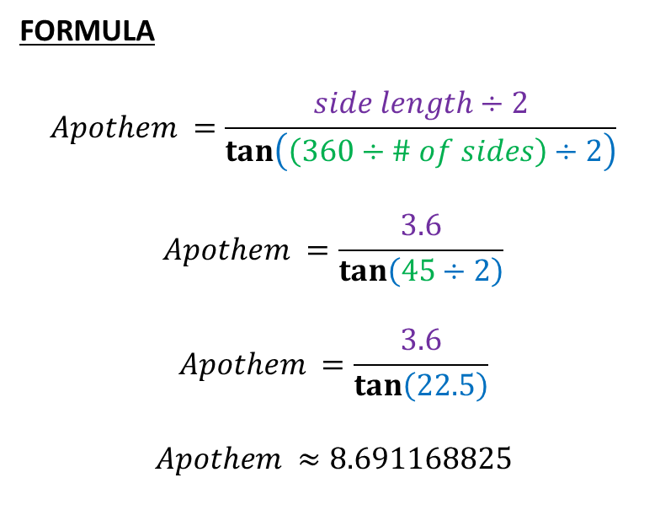
Try it – Find the apothem
$$7.2 cm$$
FORMULA
$$Apothem =\frac{side length÷2}{\tan\left(\left(360÷\# of sides\right)÷2\right)}$$
$$Apothem =\frac{3.6}{\tan\left(45÷2\right)}$$
$$Apothem =\frac{3.6}{\tan\left(22.5\right)}$$
$$Apothem ≈8.691168825$$

Slide 7
Formula Summary Page
Pythagorean Theorem $c^{2}=a^{2}+b^{2}$
To Find HEIGHT of EQUILATERAL Triangle $h=\sqrt{{\left(side\right)}^{2}−{\left(\frac{1}{2} of side\right)}^{2}}$
To Find HEIGHT of ISOSCELES Triangle $h=\sqrt{{\left(side\right)}^{2}−{\left(\frac{1}{2} of base\right)}^{2}}$
To Find APOTHEM $Apothem =\frac{side length÷2}{\tan\left(\left(360÷\# of sides\right)÷2\right)}$

