Slide 1
Area of Solids
Comes in two forms:
Lateral Area – the “walls”
Surface Area – the “walls” AND the “base(s)”
It is VERY important to know which is(are) the bases of a figure.

Slide 2
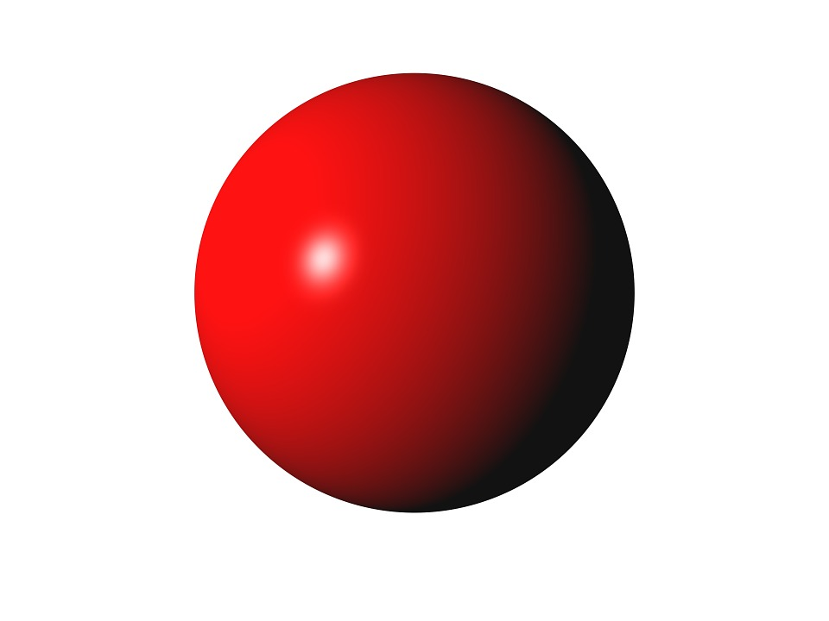
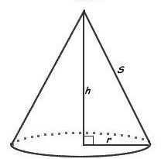
Formulas
Formulas are based on shape of faces
See 5.01 Area of Plane Figures
Two shapes with special formulas
Cone
Sphere
$$A=4πr^{2}$$
$$A_{L}=πrs$$

Slide 3
Find the Lateral Area and the Surface Area

Slide 4
Find the Lateral Area and the Surface Area

Slide 5
Find the Lateral Area and the Surface Area
$$27$$

Slide 6
Find The Surface Area of the Given Figure
Complex Solids

