Slide 1
Working Backwards
You will have to really focus on your formulas and algebra! ☺
Steps are the same as with 2D
Pick the formula
Plug in what you know
Solve Backwards

Slide 2
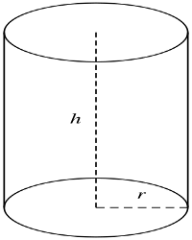
1 – Find the Missing Dimension
$$Volume=\left(A_{B}\right)\left(h_{P}\right)$$
Find the formula
Plug in what you know
Solve backwards
$$V=\left(πr^{2}\right)\left(h_{P}\right)$$
$$238.7610417=\left(πr^{2}\right)\left(19\right)$$
$$19 cm$$
$$12.56637061=πr^{2}$$
$$4=r^{2}$$
$$Volume=238.7610417 cm^{3}$$
$$radius=2 cm$$

Slide 3
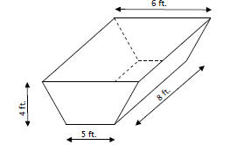
2 – Find the Missing Dimension
$$Volume=176 ft^{3}$$

Slide 4
3 – Find the Missing Dimension
A cylinder has a volume of approximately 314 $cm^{3}$ and a radius of 5 cm. Solve for the height of the cylinder.

Slide 5
4 – Find the Missing Dimension
A cone has a volume of 37.68$mm^{3}$ and a height of 9 mm. Find the radius.

Slide 6
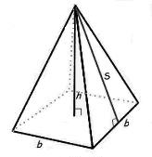
5 – Find the Missing Dimension
The pyramid to the left has a surface area of 172.8 cm²
The square base has sides measuring 6 cm
Find the slant height
Find the VOLUME of the Pyramid

