Slide 1
Equivalent Solids
Same Volume
Shape does NOT matter

Slide 2
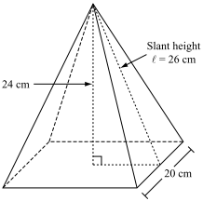
Are these two figures equivalent?
$$2 cm$$
$$6.08276253 cm$$
$$6 cm$$
$$2 cm$$
$$2 cm$$
$$2 cm$$
$$2 cm$$

Slide 3
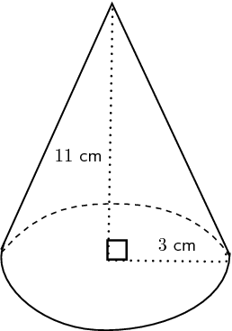
Are these two figures equivalent?
$$7 cm$$
$$10 cm$$
$$3.44 cm$$
$$5.3612 cm$$
$$5 cm$$

Slide 5
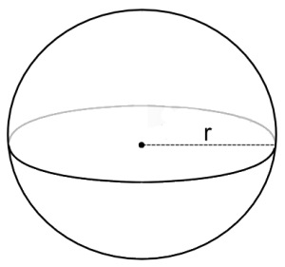
Given that the two figures below ARE equivalent, what is the radius of the sphere?
$$7 cm$$
$$6 cm$$
$$7.1\overline{6} cm$$

