Slide 1
Unit 6 – Voting Procedures
Day 1

Slide 2
To Vote
One to Three:
1) MOST favourite
to
3) LEAST favourite
NO DUPLICATE NUMBERS
Movies
Super Powers
Festivals
Interests

Slide 3
Rank the following Movies in order of preference to see
Furious 7
Get Hard
Longest Ride
Results

Slide 4
Rank the following Super Powers
Speed
Flight
Strength
Results

Slide 5
Rank the following Festivals
Bluesfest
Boots and Hearts
Havelock Jamboree
Results

Slide 6
Rank the following Interests
Music
Reading
Movies
Results

Slide 7
Results - 23
 | 6 | 3 | 8 | 2 | 1 | 3
First | A | A | B | B | C | C
Second | B | C | A | C | A | B
Third | C | B | C | A | B | A
Majority
Plurality
Borda
Condorcet
Elimination

Slide 8
Elimination Example
A = 9+1=10
B = 10+3 = 13
C = 4 - eliminated

Slide 9
Condorcet Example
A vs B A vs C B vs C
6 8 16 7
2
1 3
10 13

Slide 10
Borda Example
Candidate A:
2(9)+1(9)=27 points
Candidate B:
2(10)+9=29 points
Candidate C:
2(4)+5 = 13 points

Slide 11
Plurality Voting
The candidate who receives the most first choice votes is declared as the winner
This is what you are accustom to using
Try It

Slide 12
Majority Rule
The candidate who receives an absolute majority* of first choice votes is declared as the winner
Absolute Majority – more than half the votes
Try It

Slide 13
Borda Count
The candidate who receives the most points is declared as the winner

Slide 14
Borda Count - Process
Each rank of voting is given a point value
If there are 3 Candidates
First choice votes = 2 points each
Second choice votes = 1 point each
Third choice votes = 0 points each
The candidate who receives the most points is declared as the winner
Try It

Slide 15
Condorcet Method
The candidate who ranks higher than
ALL of the others is declared as the winner

Slide 16
Condorcet Method - Process
One-on-One comparisons are done with each candidate (who ranks first by each voter)
If there are 3 Candidates
The candidate who defeats* ALL of the others is declared as the winner
Defeats* - ranks higher every time
A vs B A vs C B vs C
Try It

Slide 17
Elimination Method
The candidate who receives an absolute majority* is declared as the winner
Absolute Majority – more than half the votes

Slide 18
Elimination Method - Process
First choice votes are tallied
If no winner
Candidate with fewest votes is eliminated and their votes go to the second choice candidate
If no winner
Process repeats until winner declared
The candidate who receives an absolute majority* is declared as the winner
Try It

Slide 19
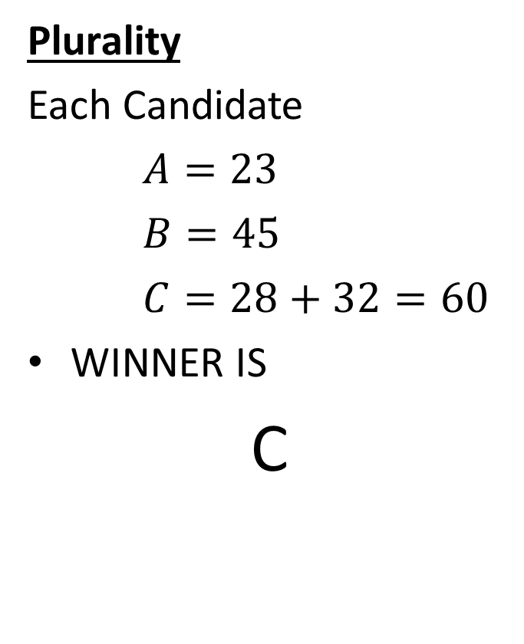
Example
 | 45 | 32 | 28 | 23
First | B | C | C | A
Second | C | B | A | B
Third | A | A | B | C
Plurality
Each Candidate
$A=23$
$B=45$
$C=28+32=60$
WINNER IS
C

Slide 20
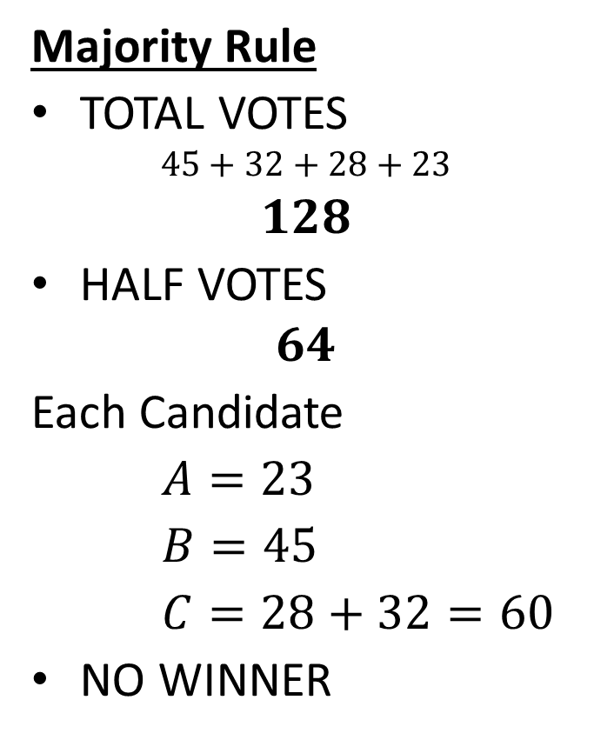
Example
 | 45 | 32 | 28 | 23
First | B | C | C | A
Second | C | B | A | B
Third | A | A | B | C
Majority Rule
TOTAL VOTES
$$45+32+28+23$$
$$128$$
HALF VOTES
$$64$$
Each Candidate
$A=23$
$B=45$
$C=28+32=60$
NO WINNER

Slide 21
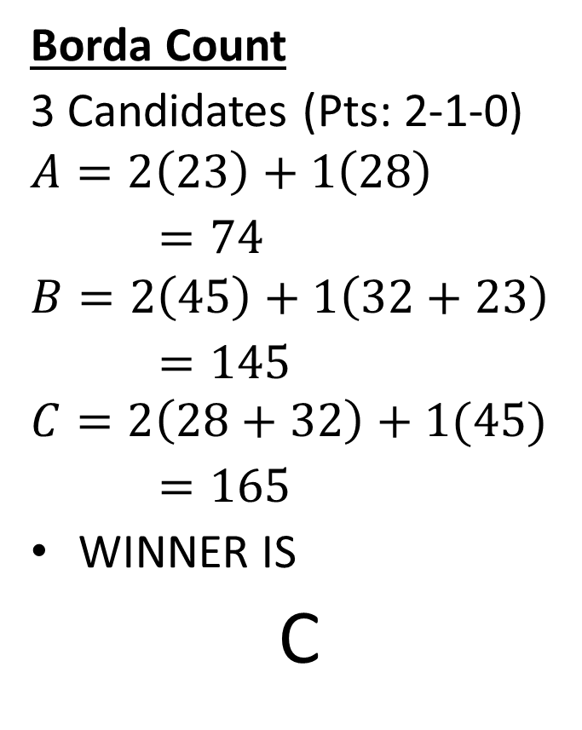
Example
 | 45 | 32 | 28 | 23
First | B | C | C | A
Second | C | B | A | B
Third | A | A | B | C
Borda Count
3 Candidates (Pts: 2-1-0)
$$A=2\left(23\right)+1\left(28\right)$$
$=74$
$$B=2\left(45\right)+1\left(32+23\right)$$
$=145$
$$C=2\left(28+32\right)+1(45)$$
$=165$
WINNER IS
C

Slide 22
Example
 | 45 | 32 | 28 | 23
First | B | C | C | A
Second | C | B | A | B
Third | A | A | B | C
Condorcet Method
A vs B
A vs C
B vs C
WINNER IS
B
$$28+23$$
$$45+32$$
$$=51$$
$$=77$$
$$23$$
$$45+32+28$$
$$=105$$
$$45+23$$
$$32+28$$
$$=68$$
$$=60$$

Slide 23
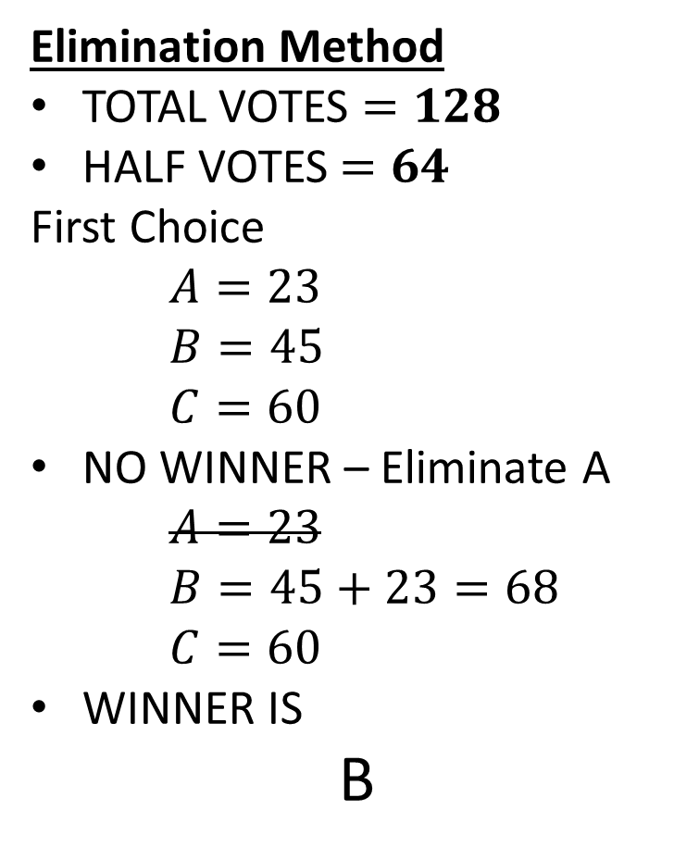
Example
Elimination Method
TOTAL VOTES $=128$
HALF VOTES$=64$
First Choice
$A=23$
$B=45$
$C=60$
NO WINNER – Eliminate A
$A=23$
$B=45+23=68$
$C=60$
WINNER IS
B
 | 45 | 32 | 28 | 23
First | B | C | C | A
Second | C | B | A | B
Third | A | A | B | C

Slide 24
Practice
Visions
Page 113
# 1ab, 2, 3, 4

