Slide 1
Approval Voting
The candidate who receives the most votes is declared as the winner

Slide 2
Approval Voting - Process
Votes cast votes for as many candidates as they like (approve of)
Votes are counted
The candidate who receives an the most votes is declared as the winner

Slide 3

Example
 | 45 | 32 | 28 | 23
 | A | B | A | A
 | D | C | B
 |  | D | C
Approval Voting
$$A=$$
$$B=$$
$$C=$$
$$D=$$
WINNER IS

Slide 4
Proportional Representation
This is the method that is used to determine how many of the available seats within a committee will go to each party that is interested in contributing to the decision-making process
Think of our government:
Each party is allowed so many senators to represent them based on the votes they receive in specific areas

Slide 5
Terminology
Committee – a collective group with members from each party
Party – a group of people who share the same view points
Seats – the number of positions available on the committee

Slide 6
Proportional Representation
Decision-making power is distributed among the parties in proportion to the number of votes they have received
Formula Used
$$(number of seats)×\frac{(votes for party)}{(total number of voters)}$$

Slide 9
Organizer
Candidates | Number of Votes | $$(number of seats)×\frac{(votes for party)}{(total number of voters)}$$ | Integer | Decimal | Added Seats | TOTAL SEATS
TOTAL

Slide 10
Steps
Determine number of seats to be filled
Determine the number of voters and how many votes each party receives
Use the formula for each party
Fill in integer and decimal sections on organizer
Distribute seats based on integer found with the formula
Determine how many seats are left over
Distribute the seats in order of decimals (highest to lowest) until all seats are given out

Slide 11
Example
A parliamentary representation is being generated for the Outaouais Region. There are 10 seats available in Parliament for this region.
Votes have been tallied and the results are below:
Party | A | B | C | TOTAL
Number of Votes Received | 15235 | 23429 | 2893 | 41557

Slide 12
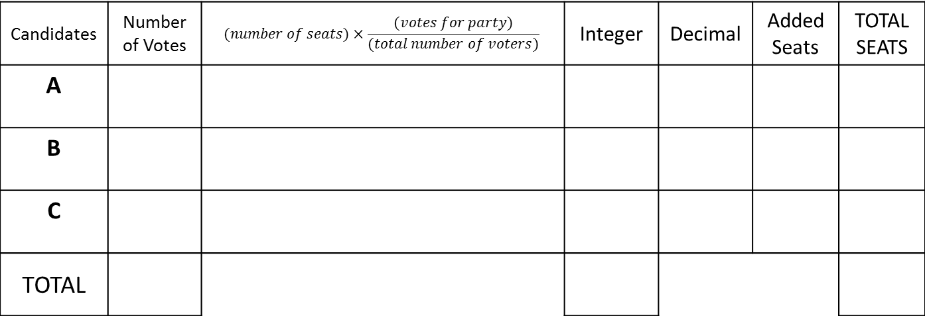
Steps
Party | A | B | C | TOTAL
Number of Votes Received | 15235 | 23429 | 2893 | 41557
Determine number of seats to be filled
Determine the number of voters
Use the formula for each party (do not round)
Steps 4-7 on chart
Candidates | Number of Votes | $$(number of seats)×\frac{(votes for party)}{(total number of voters)}$$ | Integer | Decimal | Added Seats | TOTAL SEATS
A
B
C
TOTAL

Slide 13
Using Percentages
In a region comprising 10 districts of equal population, 10 seats must be attributed, one for each district. The following are the results:
 | 1 | 2 | 3 | 4 | 5 | 6 | 7 | 8 | 9 | 10 | TOTAL
A | 33% | 34% | 35% | 40% | 55% | 33% | 32% | 38% | 39% | 41% | 38%
B | 32% | 25% | 26% | 45% | 40% | 33% | 33% | 23% | 32% | 47% | 33.6%
C | 35% | 41% | 39% | 15% | 5% | 34% | 35% | 39% | 29% | 12% | 28.4%
By Plurality:
Party A wins 2
Party B wins 2
Party C wins 6
Party C has a majority, even though they received the fewest votes
By Proportional Rep:
Party A wins 38% of seats = 4
Party B wins 33.6% of seats = 3
Party C wins 28.4% of seats = 3
Party A leads with a minority
The TOTAL is the average of all of the percentages

