Slide 1
Review Unit
Solving Algebraic Word Problems

Slide 2
Steps
Read the problem (several times)
Identify the unknowns
Represent the unknowns with variables
Create an equation based representing the situation, paying careful attention to wording for the order in which operations need to occur
Solve equation for variable
Answer the question using a complete statement

Slide 3
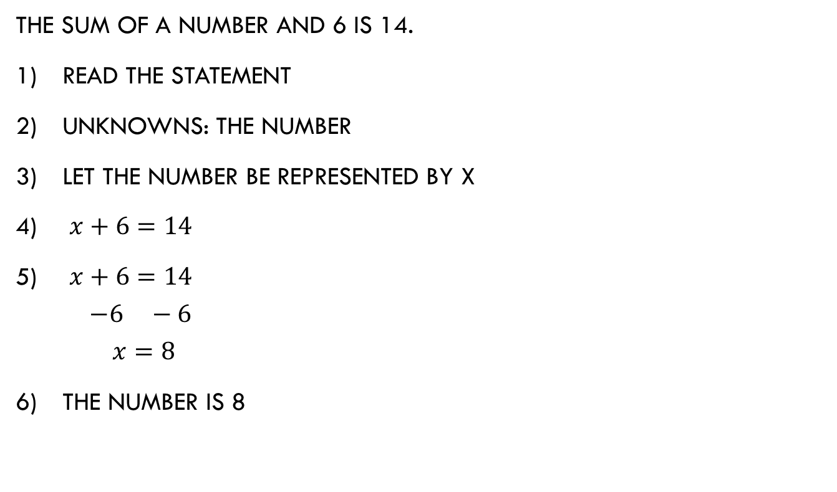
The sum of a number and 6 is 14.
Read the statement
Unknowns: the number
Let the number be represented by x
$x+6=14$
$x+6=14$
$$−6 −6$$
$$x=8$$
The number is 8

Slide 4
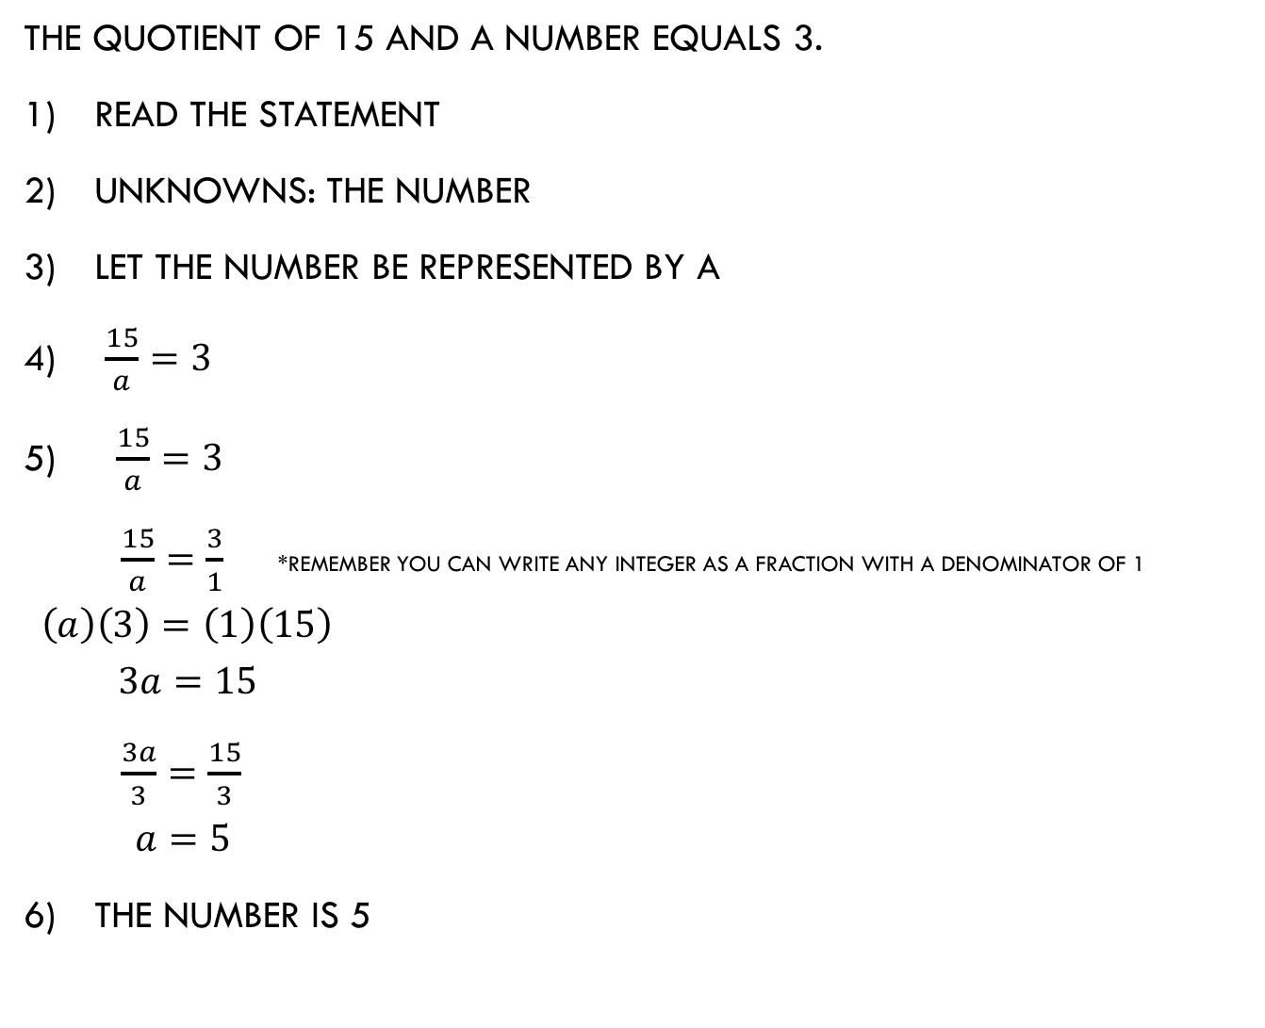
The quotient of 15 and a number equals 3.
Read the statement
Unknowns: the number
Let the number be represented by a
$\frac{15}{a}=3$
$\frac{15}{a}=3$
$\frac{15}{a}=\frac{3}{1}$ *remember you can write any integer as a fraction with a denominator of 1
$$\left(a\right)\left(3\right)=\left(1\right)\left(15\right)$$
$$3a=15$$
$\frac{3a}{3}=\frac{15}{3}$
$$a=5$$
The number is 5

Slide 5

One-fifth of a number is 15.
Read the statement
Unknowns: the number
Let the number be represented by y
$\frac{1}{5}y=15$
$\frac{1}{5}y=15$
$\left(\frac{1}{5}\right)\left(\frac{y}{1}\right)=15$
$$\frac{y}{5}=\frac{15}{1}$$
$$\left(1\right)\left(y\right)=(5)(15)$$
$y=75$
The number is 75

Slide 6

Four times a number is 48.
Read the statement
Unknowns: the number
Let the number be represented by $b$
$\left(4\right)\left(b\right)=48$
$\left(4\right)\left(b\right)=48$
$$4b=48$$
$$\frac{4b}{4}=\frac{48}{4}$$
$$b=12$$
The number is 12

Slide 7

17 more than four times John’s age is 89.
Read the statement
Unknowns: john’s age
Let john’s age be represented bY $a$
$17+\left(4\right)\left(a\right)=89$
$17+\left(4\right)\left(a\right)=89$
$$17+4a=89$$
$$−17 −17$$
$$4a=72$$
$$\frac{4a}{4}=\frac{72}{4}$$
$$a=18$$
John’s age is 18.

Slide 8

If we double john’s age plus eight, we get 42.
Read the statement
Unknowns: john’s age
Let john’s age be represented bY $a$
$\left(2\right)\left(a+8\right)=42$
$\left(2\right)\left(a+8\right)=42$
$2a+16=42$
$$−16 −16$$
$$2a=26$$
$$\frac{2a}{2}=\frac{26}{2}$$
$$a=13$$
John’s age is 13.

Slide 9
Now let’s think about word problems that contain two or more variables…

Slide 10
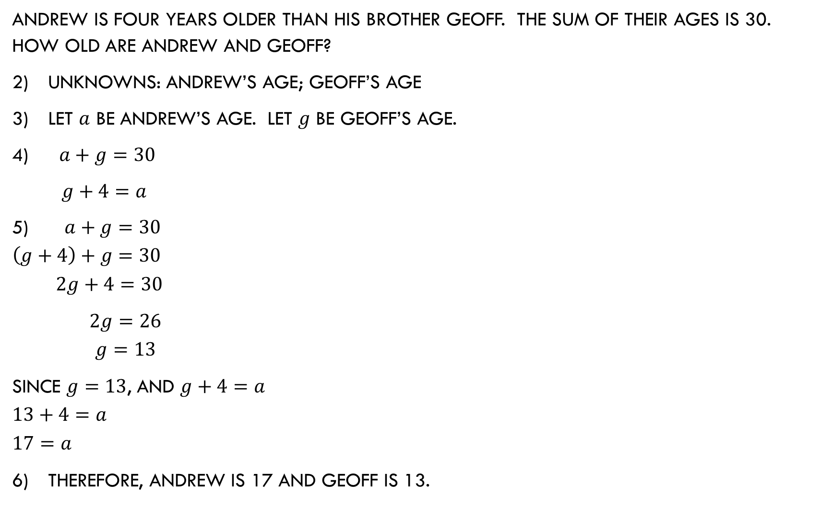
Andrew is four years older than his brother geoff. The sum of their ages is 30. how old are andrew and geoff?
Unknowns: Andrew’s age; Geoff’s age
Let $a$ be Andrew’s age. Let $g$ be geoff’s age.
$a+g=30$
$g+4=a$
$a+g=30$
$$\left(g+4\right)+g=30$$
$$2g+4=30$$
$2g=26$
$$g=13$$
Since $g=13$, and $g+4=a$
$$13+4=a$$
$$17=a$$
Therefore, andrew is 17 and geoff is 13.

Slide 11
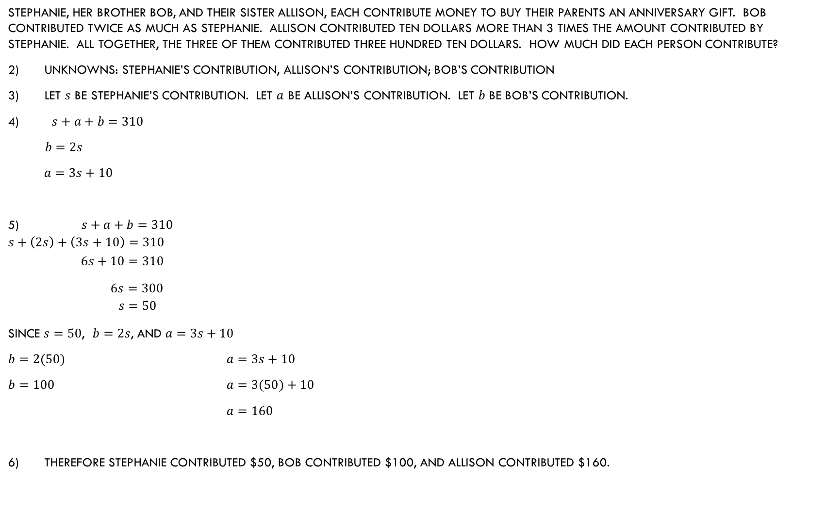
Stephanie, her brother bob, and their sister allison, each contribute money to buy their parents an anniversary gift. Bob contributed twice as much as stephanie. Allison contributed ten dollars more than 3 times the amount contributed by stephanie. All together, the three of them contributed three hundred ten dollars. How much did each person contribute?
Unknowns: stephanie’s contribution, allison’s contribution; bob’s contribution
Let $s$ be stephanie’s contribution. Let $a$ be allison’s contribution. Let $b$ be bob’s contribution.
$s+a+b=310$
$b=2s$
$a=3s+10$
$s+a+b=310$
$$s+\left(2s\right)+\left(3s+10\right)=310$$
$$6s+10=310$$
$6s=300$
$$s=50$$
Since $s=50$, $b=2s$, and $a=3s+10$
$b=2(50)$ $a=3s+10$
$b=100$ $a=3(50)+10$
$a=160$
Therefore stephanie contributed $50, bob contributed $100, and Allison contributed $160.

