Slide 1
Chapter 7
The Human Organism and the External World
Main Topics:
The Nervous System
The Sensory Organs
Musculoskeletal System

Slide 2
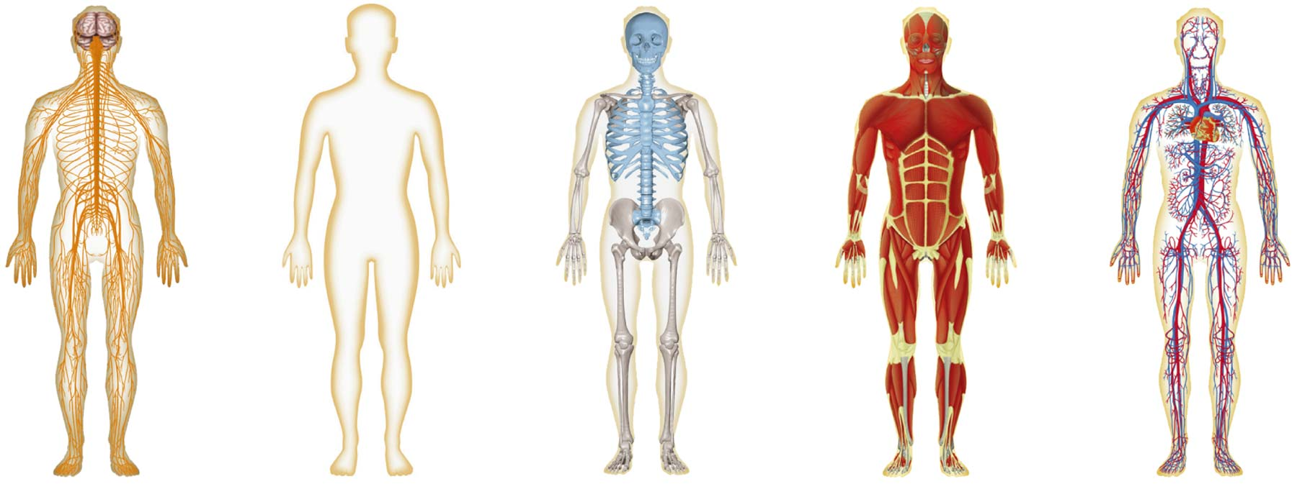
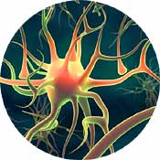
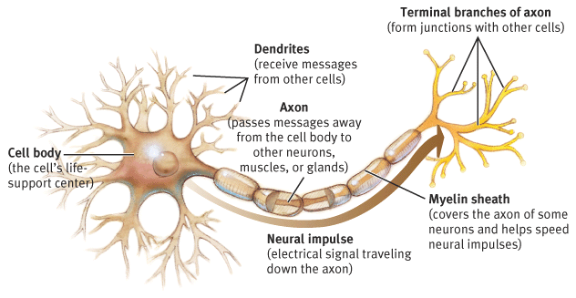
Nervous System
Topics:
Neurons
Nerve impulse
Synapse

Slide 3
Functions of the Nervous System
Receives information
Transmits information to the processing center (brain)
Stores information
Transmits information back to the body

Slide 4
Additional Function of Nervous System
COMMUNICATION
Controls bodily functions
Responds to internal & external stimuli
      Like swinging at a baseball
        *Click on link above*

Slide 5
Neurons makeup Nervous System
  Dendrites
    branches that receive info
  Axon
    sends message to other neurons
  Myelin sheath
    insulates signal thru axon
Nucleus
Axon Terminals
Cell Body
Myelin Sheath
Axon
Dendrites
Nodes

Slide 6
Neurons makeup Nervous System
  Axon Terminals
    Hooks up with muscles, glands or next neuron
  Cell body
    Takes care of all metabolic processes of neuron
Nucleus
Axon Terminals
Cell Body
Myelin Sheath
Axon
Dendrites
Nodes

Slide 7
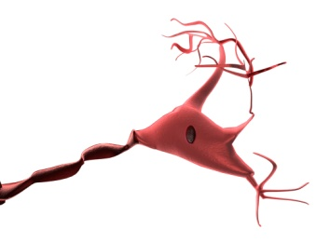

Characteristics of Neurons
A neuron can be stimulated
    It turns the stimulus into an electrochemical signal called a nerve impulse.
A neuron is conductive
    It transmits the impulse from one neuron to another.
Neurons consume a lot of oxygen and glucose
    It can only survive a few minutes without oxygen
A neuron can live over 100 years
    People keep the same neurons throughout their lives.
A neuron cannot reproduce itself
    They cannot be replaced if they are destroyed.

Slide 8
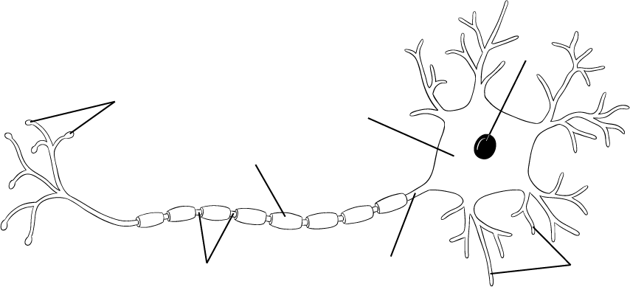
Passing a signal
Synapse:
  A transition zone or junction between two neurons that allows a nerve impulse to be transmitted.
    At a synapse, the axon of one neuron almost touches the dendrite of another. There is actually a very tiny gap.
Synapse
Synapse

Slide 9

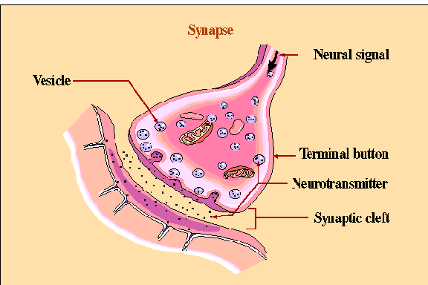
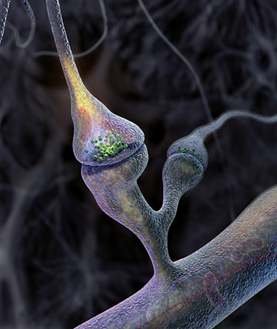
Transmitting signal btw neurons
  Neurotransmitters
    chemicals used to send signals across the tiny gap at a synapse
    Acetylcholine - used for muscle nerves
Synapse

Slide 10
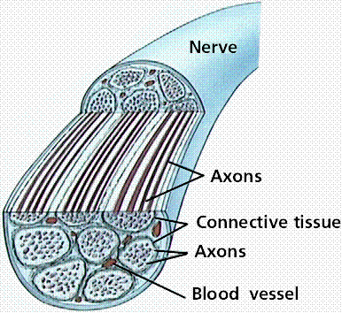
Nerves
A nerve is a structure that helps transmit information between the central nervous system and the various regions of the body.
A nerve contains:
  Bundles of neurons and their axons.
  Protective connective tissue.
  Blood vessels.

Slide 11
Types of nerve tissue:
  Sensory receptors (receptors)
    Picks up stimulus and transforms it into an impulse
  Sensory nerves (Incoming stimulus)
    connect sensory organs to spine and/or brain.
  Motor nerves (Outgoing response)
    connect (spinal cord and brain) to (muscles and glands)
  Interneurons (nervous system highway)
    Connect sensory and motor neurons and carry impulses between them

Slide 12
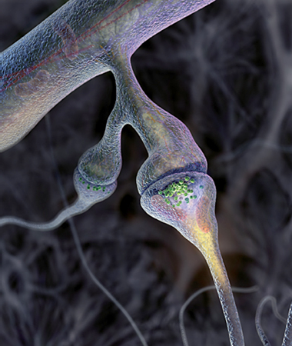
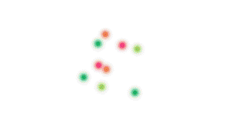
Movement of an Impulse
An Impulse is an electro-chemical signal
It passes through neurons that either:
  pick up sensory info and send impulse for processing (sensory neurons)
    (to the brain/spinal cord) or
  Send impulse from processor to effect a response (motor neurons)
Synapse
Synapse

Slide 13
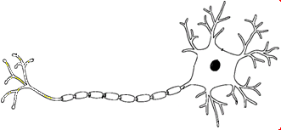
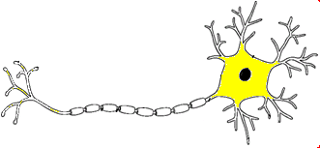
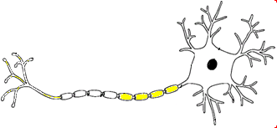
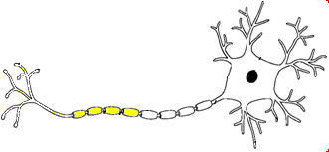
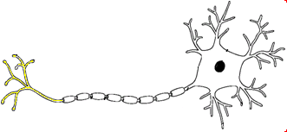
Nerve Impulses

Slide 14
Quick definitions
Neuron: a specialized nerve cell
Impulse: an electro-chemical signal transmitted through a neuron (or nerve).
CNS (Central Nervous System): The brain & spinal cord.
PNS (Peripheral Nervous System) : The other nerves. They connect different parts of the body to the CNS.
Stimulus: anything perceived by a living organism that can trigger a reaction. Examples: light, sound, heat etc.
Sensory neuron: one that sends an impulse towards the CNS
Motor neuron: one that carries an impulse away from the brain towards a muscle or gland
Interneurons: neurons in the brain & spinal cord that may connect sensory and motor neurons, and can process impulses.
Synapse: A transition zone where two neurons connect that allows a nerve impulse to be transmitted.

Slide 15
Assignments
Read pages 201 to 204 in textbook
Do pages 121 and 122 in workbook.

Slide 16
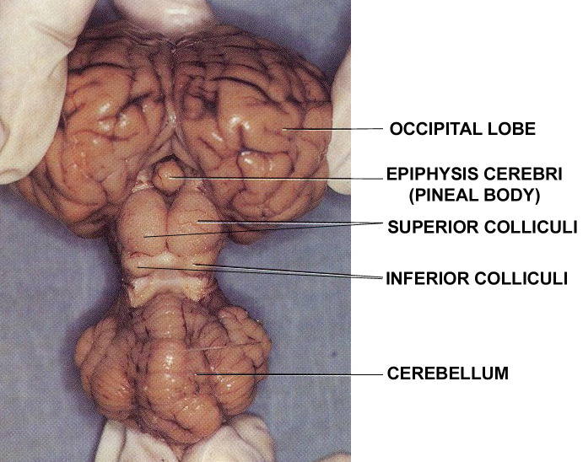
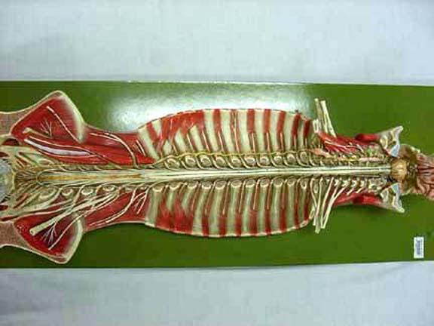
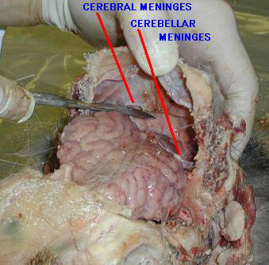
Divisions of the Nervous System
Topics:
Brain/Central Nervous System
Spinal Cord
Peripheral Nervous System
Sense Organs

Slide 17
Divisions of the Nervous System
Cranial & spinal nerves make up the PNS
Brain controls the CNS, spinal cord connects
Nervous System
Central Nervous System CNS |  | Peripheral Nervous System PNS
Brain | Spinal Cord | Somatic Nervous System | Autonomic Nervous System ANS
 |  | Sympathetic Speeds up | Parasympathetic Slows down
Somatic nervous system is under voluntary control
ANS works without conscious thought. It’s all automatic

Slide 18
Peripheral Nervous System
“P.N.S.”
Connects different parts of your body to the C.N.S. (ie. to the brain & spinal cord)
Physically, the P.N.S. consists of
  12 pairs of large nerves from your brain
    (cranial nerves)
  31 pairs of large nerves from your spinal cord
    (spinal nerves)
  Hundreds of small, branching nerves
    Going to all parts of your body.

Slide 19
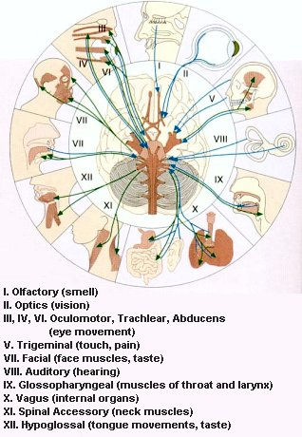
Cranial Nerves
(optional enrichment material)
There are 12 pairs of peripheral nerves that leave from the base of the brain.

Slide 20
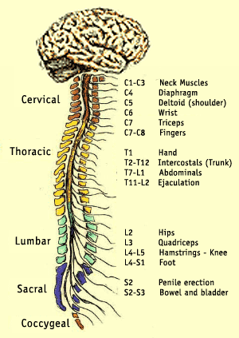
The Spinal Nerves
(optional enrichment material)
Nerves from the spinal cord
There are 31 pairs of spinal nerves branching off different parts of the spinal column.
The nerves are named after the regions of the spine.
http://www.christopherreeve.org/Research/Research.cfm?ID=178&c=21

Slide 21
Peripheral Nervous System
“P.N.S.”
Connects different parts of your body to the C.N.S. (ie. to the brain & spinal cord)
Physically, the P.N.S. consists of
  12 pairs of large nerves from your brain
    (cranial nerves)
  31 pairs of large nerves from your spinal cord
    (spinal nerves)
  Hundreds of small, branching nerves
    Going to all parts of your body.

Slide 22
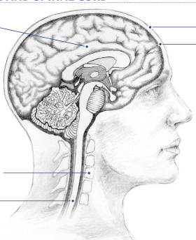
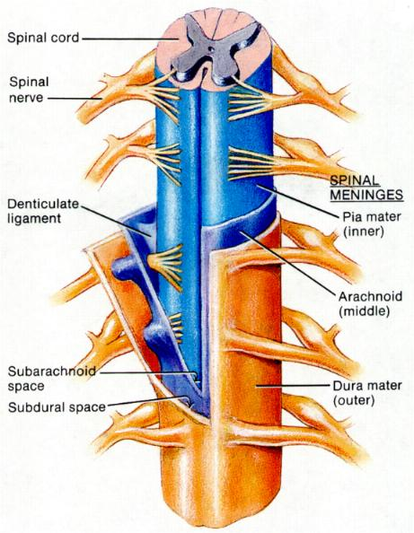
Central Nervous System
“CNS”
Job: relays messages, processes and analyzes info
Contains: Brain & Spinal Cord
CNS is wrapped in meninges
  Three layers of connective tissue
    Dura mater
    Arachnoid Meninges
    Pia mater
  Cerebrospinal Fluid between layers of meninges
    Fluid is a shock absorber

Slide 23
The Brain
The brain is composed of the parts of the central nervous system located inside the cranium (inside your skull)
The brain has three main regions
    The Cerebrum
    The Cerebellum
    The Brainstem (AKA medulla oblongata)

Slide 24
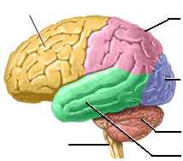
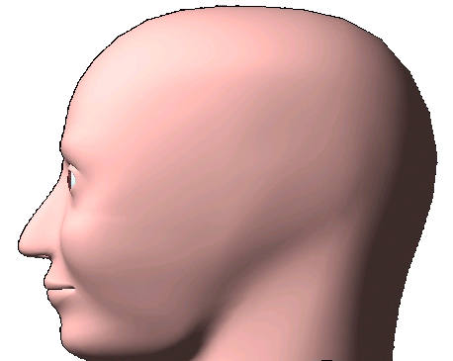
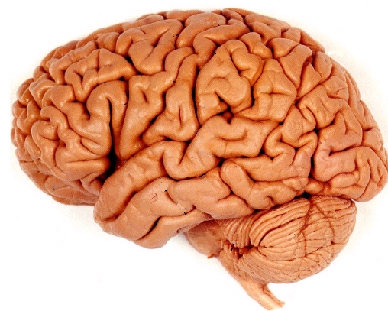
Parts of the Brain (optional enrichment)
Cerebrum
The main part
Of the brain.
Movement
Touch
Thought
Taste
Speech
Vision
Cerebellum
Coordination
Brain Stem
(medulla oblongata)
Autonomic systems
Hearing, smell

Slide 25


Functions of the Cerebrum
(see table on page 209)
Function | Description
Controls voluntary movement | When we want to move our arm, the cerebrum sends a nerve impulse to our motor nerves.
Interprets messages picked up by the senses | The cerebrum analyzes and identifies images, sounds, smells from impulses coming from our sense organs.
Controls intelligence | Problem solving, reading, writing, speaking are just a few of the intellectual activities controlled by the cerebrum.
Controls emotion | Manages emotions like fear, joy, sadness, etc.
Regulates physiological functions | The hypothalamus and pituitary are connected closely to the cerebrum. They control thirst, hunger, alertness and temperature regulation.

Slide 26
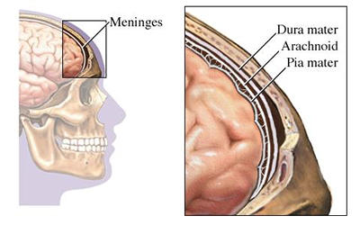
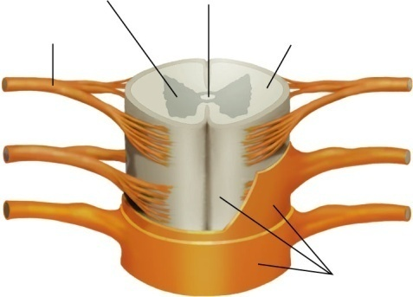
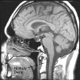
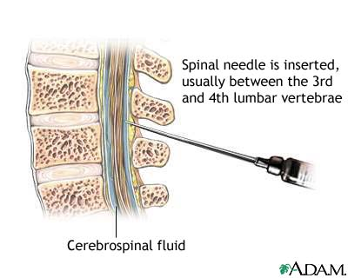
Structure of the CNS Quiz
Structure of CNS:
  Which pictures represent the meninges?
  Cerebrospinal fluid?

Slide 27
Meningitis
(optional enrichment topic)
Meningitis is a disease of the meninges and of the cerebral spinal fluid between them.
It can be very serious and even kill you.
If you have meningitis a doctor may perform a “spinal tap” on you, taking fluid out of your spine to test it
Meningitis can usually be cured if it is found early enough. If you have a very serious headache and a high fever, always go to see a doctor.

Slide 28
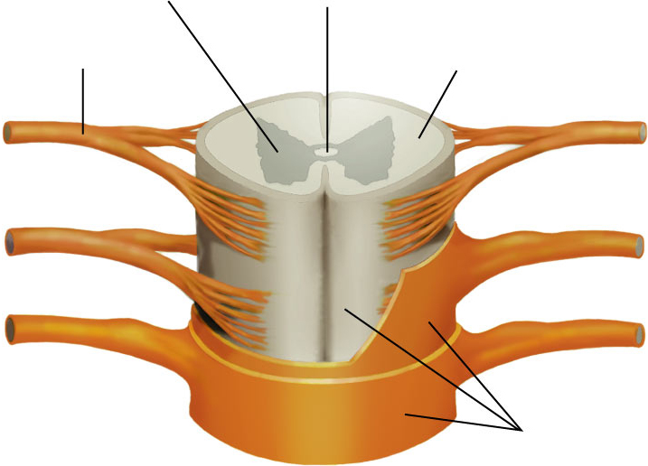
Role of the Spinal Cord
Spinal Cord is a nervous system organ that carries information from the various parts of the body to the brain. It is also the main reflex centre.
Gray matter
Spinal
Cord
Spinal
nerve
(PNS)
White matter
Meninges (protect spinal cord)

Slide 29
The Nervous subsystems
The PNS has two subsystems:
  Somatic Nervous system
    Activities that are under conscious control
      Muscle movement
  Autonomic Nervous System “ANS”
    Not under conscious control
      Heartbeat, contraction of smooth muscles/digestive system
      Sympathetic System: brakes
      Parasympathetic: gas

Slide 30
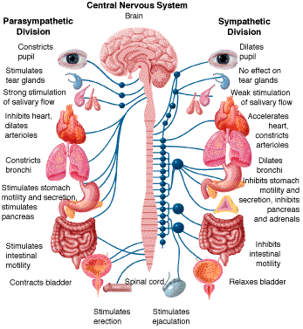
http://abdellab.sunderland.ac.uk/lectures/Parmacology/Pics/anatomy/PNS.GIF

Slide 31
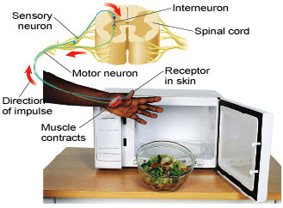
Reflexes
Involuntary, automatic response to a stimulus
Involves a simple nerve pathway called a reflex arc
The stimulus is carried by a sensory neuron and “processed” by the spinal cord
  IT SKIPS THE BRAIN!
    At least until after the finger has moved.
The response is sent to the muscles by a motor neuron

Slide 32
Exercises (PNS and CNS)
Read pages 205 to 212 in textbook.
Do pages 123 to 128 in workbook.

Slide 33
Sense Organs
There are many sense organs attached to the nervous system
  Eyes (sight)
  Ears (hearing and balance)
  Tongue and taste buds (taste)
  Nose (smell)
  Nerve endings (throughout body and in the skin) to sense:
    Touch
    Heat/cold
    Pain
    Etc.

Slide 34
The Eye
The eye is the organ of sight
  It uses a lens to focus light, onto…
  The retina (light sensitive cells) at the back of the eye.
  An iris controls the amount of light entering the eye
  The sclera, choroid, cornea and conjunctiva surround and protect the eye
  Muscles move and point the eyeball
  The optic nerve carries the image to the brain

Slide 35
Inside the Eyeball
Liquids inside the eye
  Aqueous humor: a watery liquid found near the front of the eye
  Vitreous humor (or vitreous body): a jelly-like sac of liquid in the center of the eye
The Retina
  Fovea: a very sensitive spot where the light is focused
  Blind spot: a less sensitive spot where the optic nerve enters the eyeball

Slide 36
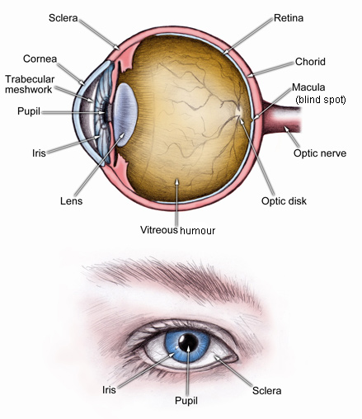
Some parts of the eye:
Outside:
Sclera: whites of the eye
  Iris: coloured part of eye
  Pupil: dark “hole” through which light enters
Inside:
  Cornea: transparent layer
  Aqueous humour: watery liquid
  Lens: focuses light
  Vitreous humour: Jelly-like material
  Retina: sensitive lining of the eye (nerve tissue)
  Choroid: supplies retina and sclera with blood

Slide 37
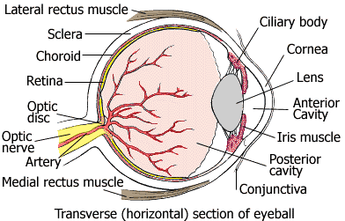
Diagram of the Eyeball

Slide 38
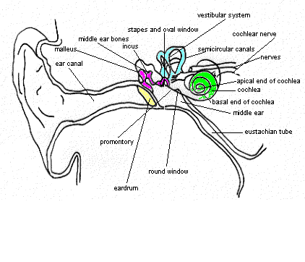
The Ear
Parts of the Ear
  Eardrum
  Ossicles (little bones)
    Malleus/hammer
    Incus/anvil
    Stapes
  Semicircular Canals
    For balance
  Cochlea
    Where sound is converted to neural pulses
Outer Ear
Outer Ear
Middle Ear
Inner Ear

Slide 39
Other sense organs
The Skin (page 217)
The nose (page 219)
The tongue (page 220)

Slide 40
Exercises (Sensory Systems)
Textbook: read p. 213 to 220
Workbook: p 129 to 132

Slide 41
The Musculoskeletal System
Includes the bones (skeleton) and the muscles (muscular system)

Slide 42

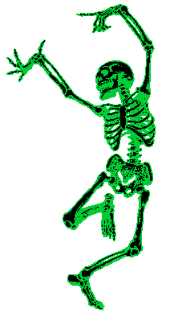
The Skeleton
Dem Bones, Dem Bones, Dem Dry bones….

Slide 43
Questions to watch for:
What are five functions of the skeleton?
How many bones are in the skeleton?
What is inside a bone?

Slide 44
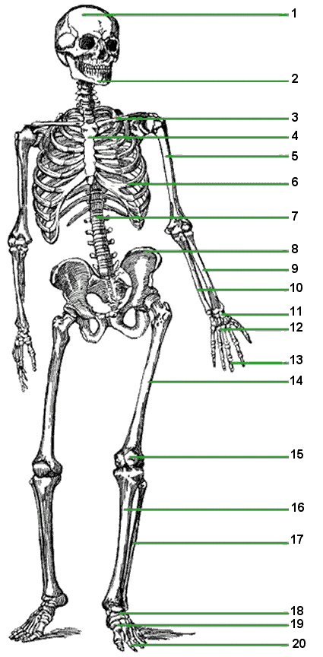
Functions of the Skeleton
The Skeleton is the name given to the collection of bones that holds the rest of our body up. Our skeleton is very important to us. It has several functions:
It protects our vital organs such as the brain, the heart and the lungs.

Slide 45
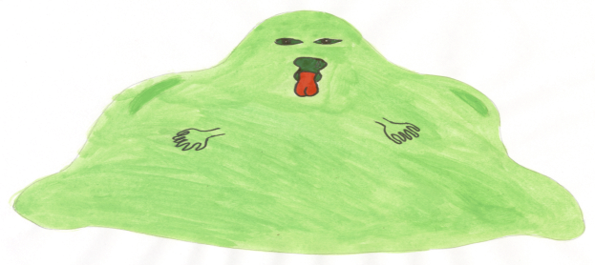
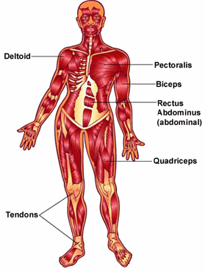
Functions of the Skeleton
Our skeleton also supports us and gives us the shape that we have. Without our skeleton, we would just be a blob of blood and tissue on the floor.
It allows movement. Because our muscles are attached to our bones, when our muscles move, they move the bones, and we move.

Slide 46
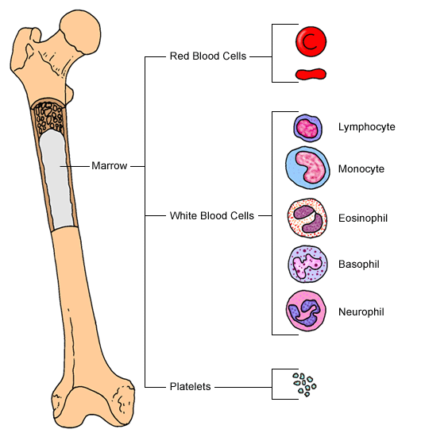
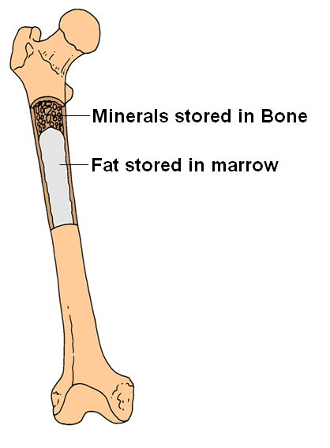
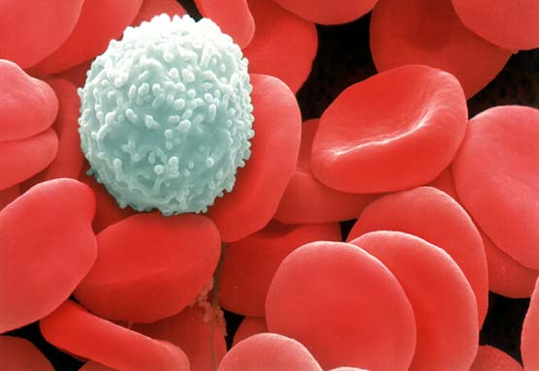
Functions of the Skeleton
Our skeleton also serves for the storage of fat and minerals (like calcium and phosphorus compounds).
Finally, our skeleton produces blood cells. The marrow of certain bones is where the red blood cells and white blood cells are formed.

Slide 47
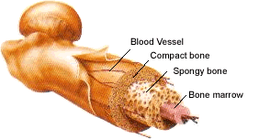
Your Bones
When you were born, your skeleton had around 350 bones. By the time you become an adult, you will only have around 206 bones. This is because, as you grow, some of the bones join together to form one bone.
Old dry bones are dead, but your bones are very much alive. They contain blood vessels, living cells, and marrow inside a compact, hard covering

Slide 48
Important Bones
What are the two main bones of the skull?
What types of bones are in the ribcage?
What are the spine and pelvis?
What are the bones of the arm?
What are the bones of the hand?
What are the bones of the leg?
What are the bones of the foot?

Slide 49
Skull
Cranium
  Starts out as 20 bones
  They fuse together into 1
Mandible
  Or jawbone
Fused Bones

Slide 50
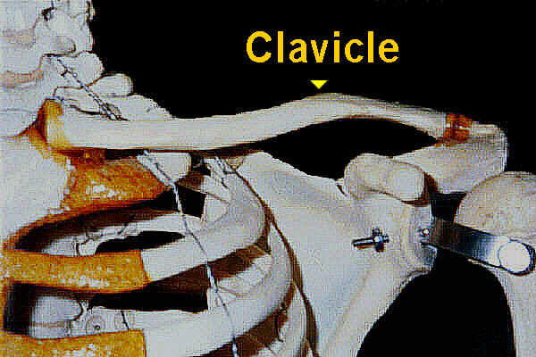
The Ribcage
Sternum
Ribs
  The average person has 12 pairs of ribs
Clavicle (above ribcage)
  Crosses above the ribcage:
  A.K.A: collarbone
Scapula (behind ribcage)
  A.K.A. shoulder blade
Scapula

Slide 51
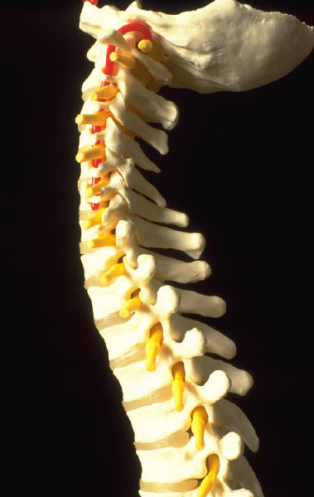
The Spine & Pelvis
Spine (backbone)
  34 bones called vertebrae
Pelvis (hipbones)
  Made of several bones fused together, including:
    Illium
    Acetabulum
    Ischium
    Pubis

Slide 52
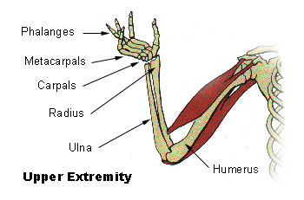
Arm Bones
The most important arm bones are:
  Humerus (upper arm)
  Radius (lower arm)
  Ulna (lower arm)
Some bones in the hand:
  Carpals (wrist)
  Metacarpals (hand)
  Phalanges (fingers)

Slide 53
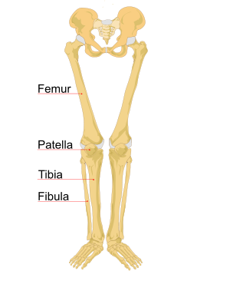
Leg Bones
The most important leg bones are
  Femur (thigh)
  Tibia (shin)
  Fibula (calf)
  Patella (kneecap)
Bones in the feet include
  Tarsals (heel)
  Metatarsals (foot)
  Phalanges (toes)

Slide 54
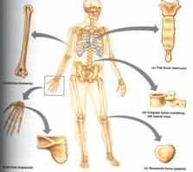
Types of Bones
Long Bones: arm bones, leg bones, finger bones
Short Bones: wrist bones, ankle bones
Flat Bones: rib bones, shoulder blades, skull bones
Irregular Bones: vertebrae, and other irregularly shaped bones

Slide 55
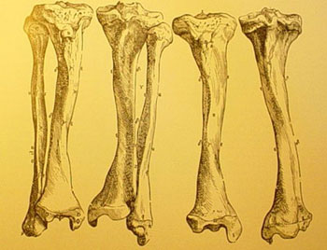
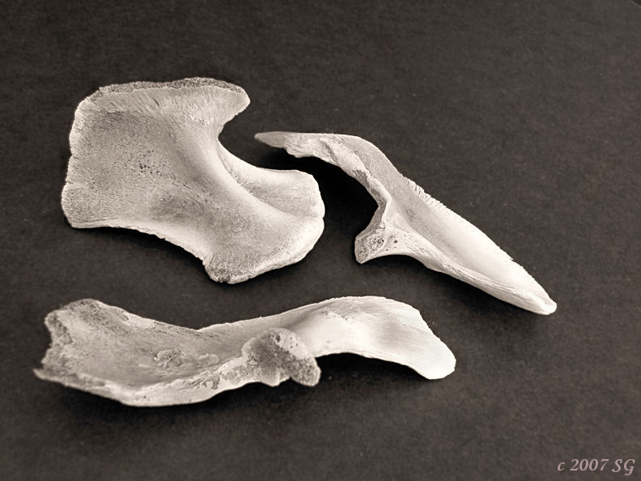


Long Bones
Flat Bones
←Short Bones
Irregular Bones →

Slide 56

Cranium (skull)
Mandible (jawbone)
Clavicle (collarbone)
Scapula (shoulder blade)
Sternum (breastbone)
Humerus
Rib
Spine (vertebrae)
Pelvis (hip bones)
Radius
Ulna
Carpals (and metacarpals)
Phalanges (fingers)
Femur
Patella (kneecap)
Tibia (shin-bone)
Fibula
Tarsal (heel bone)
Metatarsals
Phalanges (toes)

Slide 57

Parts of a Long Bone
Epiphysis→
Diaphysis→
Epiphysis→

Slide 58
Inside a bone

Slide 59
Periosteum is a tough layer of connective tissue that surrounds and protects the bone
Compact Bone is the strong outer layer of the bone. It contains Haversian Canals
Haversian Canals are channels in the bone through which blood vessels (veins and arteries) can pass. Nutrients get to the bone through these little tubes
Spongy Bone is the lighter weight but tough bone fibres inside the compact bone.
Bone Marrow is the region in the middle of the bone where blood cells are made.

Slide 60

Label Your Diagram
Spongy Bone
Haversian
Canal
Compact Bone
Periosteum
Compact Bone
Bone Marrow
Spongy Bone
Bone cell
Artery
Vein
Periosteum

Slide 61


Bones have living cells
Some are in the marrow in the center
Some are in the periosteum (surface layer)
Many are in the bone itself in arranged around little “canals” through the solid bone.

Slide 62


Joints
Bones connect at joints
There are many types of joint in the body
Joints are held together by ligaments
They are cushioned by cartilage and fluids

Slide 63
Types of Joints
The mobility of joints varies in three ways.
  I. Fixed joints: Allow little or no movement
    (ie, ribs, plates of the skull, parts of the pelvis)
  II. Slightly Movable joint: Allow a little movement
    (ie, the vertebrae, sternum to ribs)
  III. Freely Movable Joints allow a lot of motion.
    (ie. shoulder, elbow, wrist, thumb).
    There are four sub-types of movable joint:
    ①hinge joint, ②ball-and-socket joint,
    ③pivot joint, ④saddle joint

Slide 64


Types of Joints
1. Hinge joints: one direction movement
  Examples: elbow or knee

Slide 65



Types of Joints
2. Ball & Socket Joint - multiple direction movement
  Examples: shoulder or hip

Slide 66


Types of Joints
3. Pivot Joint: rotating movement
  Example: wrist and forearm

Slide 67


Types of Joints
4. Saddle Joints: Limited multiple direction movement. Example: thumb

Slide 68

Structure of Joints
Ligaments: are tough connective tissue that hold joints together (bone to bone)
Tendons: are tough connective tissues that attach muscles to joints & bones (bone to muscle)
Cartilage: softer connective tissue helps cushion joints
Muscle
Muscle
Tendon
Femur
Bone
Bone
Patella
Bursa
Ligament
Synovial fluid
Cartilage
Fat
Bone
Fibula
Tibia

Slide 69





Muscles
Muscles have the ability to contract, giving our bodies the ability to move.
Remember, there are three types of muscle
    Skeletal Muscles: attached to bones, help you move
    Smooth Muscles: in the walls of organs. Make organs move
    Cardiac Muscles: in the heart

Slide 70

Deltoid
Pectoral
Trapezius
Latissimus dorsi
Biceps
Triceps
Abdominis “abs”
Gluteus Maximus
Quadriceps
Biceps femoris
Peroneus

Slide 71
Muscles in Pairs
Muscles are very good at contracting. They can pull on a bone with great force.
Muscles are not so good at expanding. They cannot push against bones very well!
So...
Most muscles in the body occur in pairs. One muscle closes a joint (flexion) while another nearby muscle extends it back (extension)

Slide 72

Flexion →
←Extension
Biceps muscle for flexion
Triceps muscle for extension

Slide 73




Other terms used in this chapter
Abduction vs. Adduction:
    Abduction is moving a limb away from the centre
    Adduction is moving a limb towards the centre
Rotation
    Twisting or turning a limb or body part.
Abduction

Slide 74
exercises
Text Book: Read pages 221 to 228
Workbook: Do pages 133 to 138

