Slide 1
Thermoplastic
A thermoplastic is a plastic that, when heated, softens enough to be moulded; when cooled it hardens, retaining its new shape.
Most of the plastics listed on the previous slide are thermoplastics.
Alternatives to thermoplastics:
Thermosetting plastics harden permanently when heated or exposed to an energy source
Chemosetting plastics harden when two chemicals are mixed together (like epoxy)

Slide 2
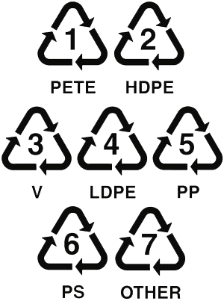
Recycling plastic
Most of the thermoplastics listed on the last slide can be recycled, but nylon and acrylic can’t be.
The plastics must be sorted before being recycled. Items made of plastic now have a sorting number stamped on them to make them easier to recycle

Slide 3
Chapter 12.5
Guides and Links in Technical Objects

Slide 4
Basic Mechanical Functions
Technical objects are made of components
Components are the parts and fluids that have a function in the object.
There are two very basic functions that component parts have:
Guiding function: A guide helps control or “guide” the motion of a moving part in a technical object.
Linking function: A link helps connect two parts of a technical object together.

Slide 5
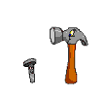
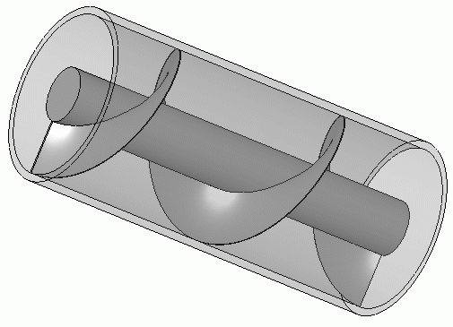
Types of motion
Name of motion symbol example
Unidirectional Translation
(slide one way)
Bidirectional Translation
(slide both ways)
Unidirectional rotation
(turn one way)
Bidirectional rotation
(turn both ways)
Helical motion
(unidirectional or bidirectional)
(screw-like motion)
A
B

Slide 6
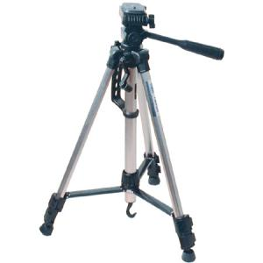
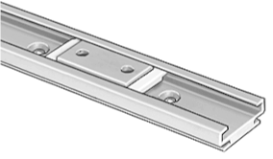
Mechanical Guides

Slide 7
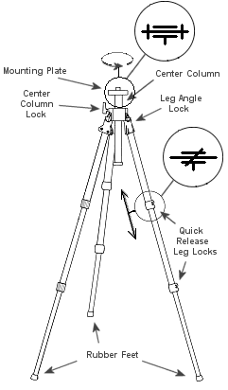
Guides
Two main types of guides are:
Rotational guides, which help a part to turn, twist or rotate
In diagrams, the simplified symbol for a rotational guide is
The motion symbol is or
Translational guides, which help a part to slide or translate
In diagrams, the simplified symbol for a translational guide is
The motion symbol is or

Slide 8
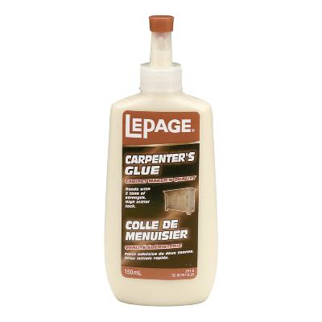
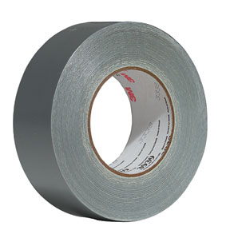
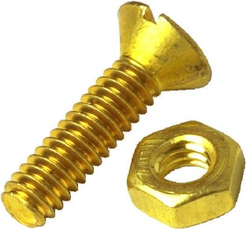
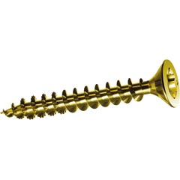
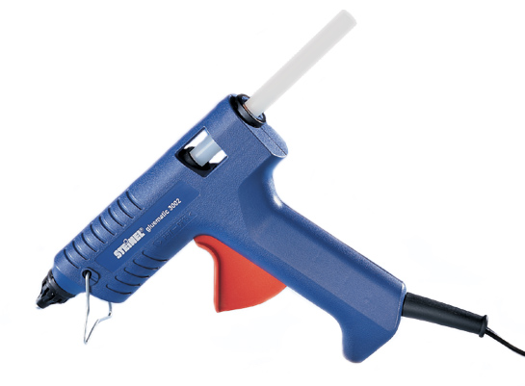
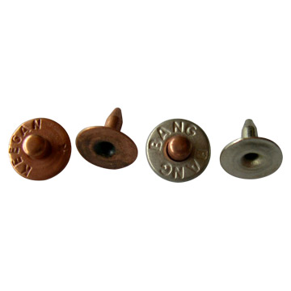
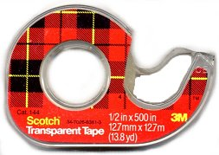
Mechanical Links

Slide 9
Links
A link connects two or more parts of a technical object.
Linking can be done by many things:
Nails, spikes • Screws
Bolts, nuts, • Rivets
Glue, • Tape
Etc….
A link can also have a guide built into it, turning it into a sliding link or a rotating link.

Slide 10
Link Characteristics Links have four pairs of characteristics. Every link has a characteristic from each pair.
Direct link vs. Indirect link
Rigid link vs. Flexible link
Removable link vs. Permanent* link
Complete link vs. Partial link
*permanent is sometimes called non-removable
When you read the section on links, make sure you list examples that illustrate the different link characteristics

Slide 11
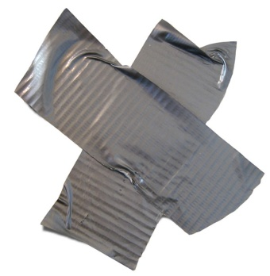
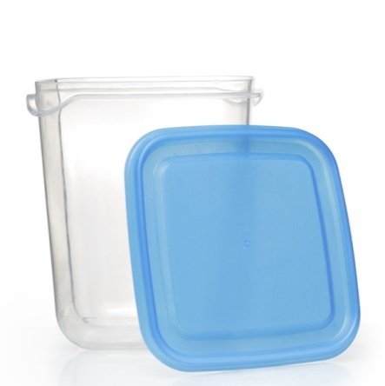
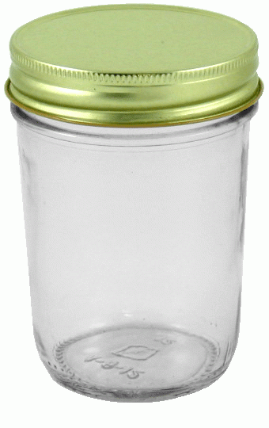
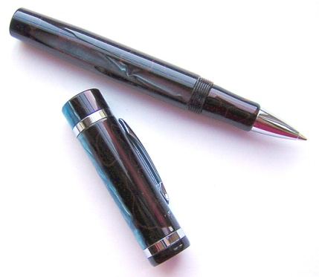
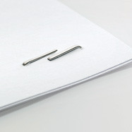
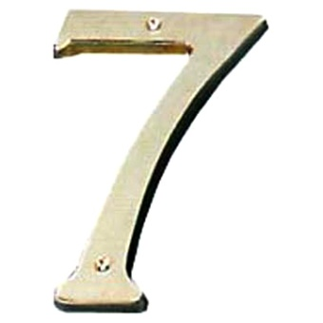
Characteristic 1: Direct vs. Indirect Links Key question: do the two main pieces need anything to hold them together?
Direct Links do not require anything else to hold them together.
Example. A jar lid or a pen cap.
Indirect Links need something else... (a nail, a screw, glue, a staple or tape) to hold them together:

Slide 12
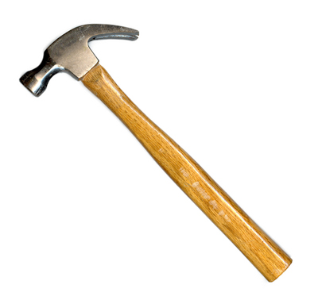
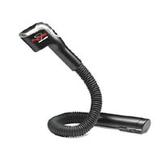
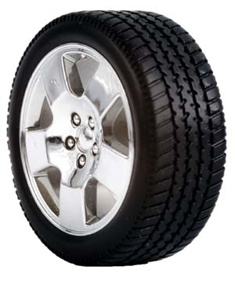
Characteristic 2: Rigid vs. Flexible Links Key question: Is the link made from solid, rigid materials?
Rigid links hold pieces together firmly, with no movement or flexibility.
Flexible links allow some flexibility or deformation between the pieces.
←Head
←Rigid Link
←Lamp
Tire→
Flexible Link→
←Handle
←Flexible Link
Wheel hub →
←battery

Slide 13
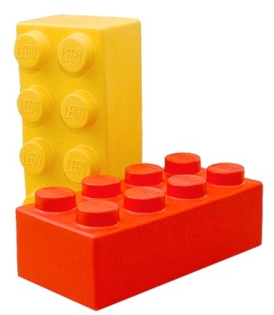
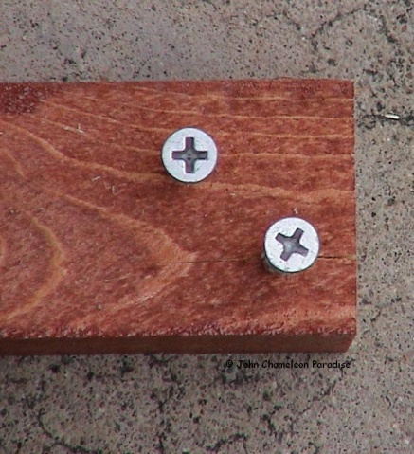
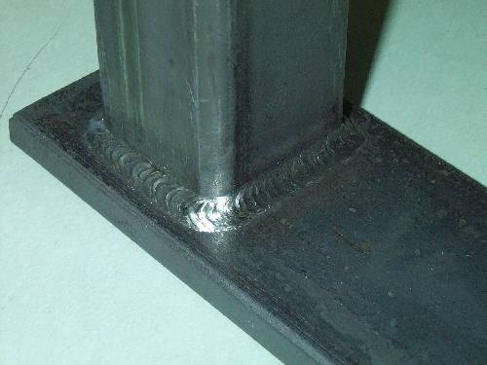
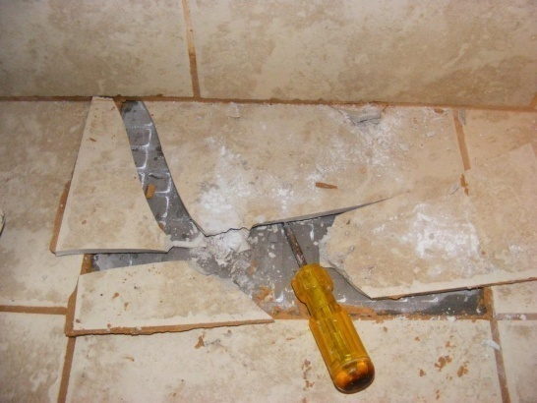
Characteristic 3. Removable vs. Permanent Link Key question: Was the link designed to be taken apart easily?
Removable links can be removed easily. Screws, staples, snap together parts etc.
Permanent links are very hard to remove. Taking them apart usually damages them. Glue, welds, mortar etc.

Slide 14
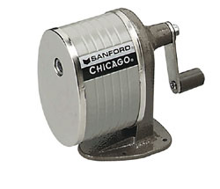
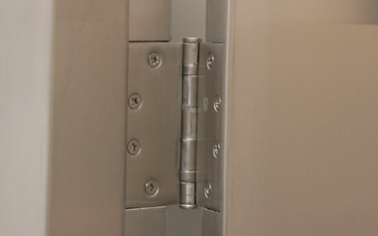
Characteristic 4. Complete vs. Partial Key question: Can the parts move?
In a complete link, there is no possible movement between the parts.
In a partial link there is possible movement between the parts.

Slide 15
Link Types The six principal types of link are:
Fixed Link (always complete)
Rotating Link (AKA. Pivot link)
Sliding Link
Sliding & Rotating link (AKA Pivoting-sliding)
Spherical Link (AKA. Ball & Socket Link)
Helical Link: (AKA. Helicoidal Link)
For each of the link types, give an example that illustrates how the link works.

Slide 16
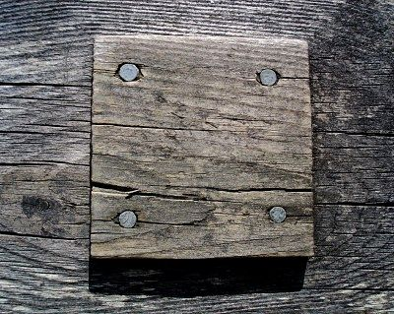
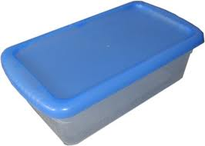
1. Fixed Link
There is no motion between the linked parts.
Fixed links are always “complete”, never “partial”
However they can be direct or indirect, rigid or flexible, permanent or removable
No motion
No motion
No motion (when sealed)

Slide 17
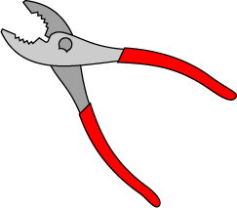
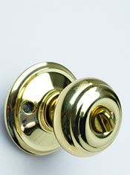
2. Rotating Link
The guided part can undergo rotation around one axis. (in other words, one part can rotate).
Rotating links are always partial, never complete
They can be direct or indirect, removable or permanent, rigid or flexible.
Rotating links contain a rotational guide.

Slide 18
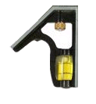
3. Sliding Link
The guided part can undergo translational motion on one axis
(in other words, one part can slide.)
Sliding links are always partial, never complete.
Sliding links contain a translational guide

Slide 19
4. Sliding Rotating Link
The guided part can undergo rotational and translational motion on the same axis.
(in other words, the part can rotate and slide at the same time.)

Slide 20
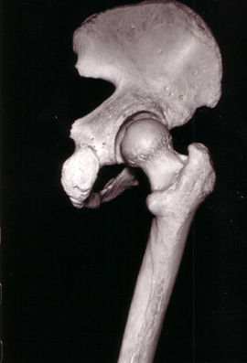
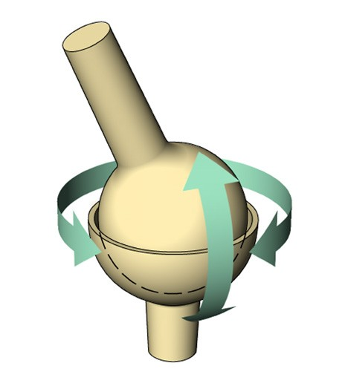
5. Spherical Link
The guided part can undergo rotational motion in many directions.
(in other words, it can rotate several ways)
Spherical links are always partial, never complete.

Slide 21
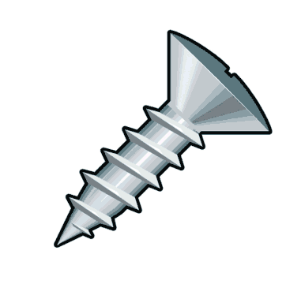
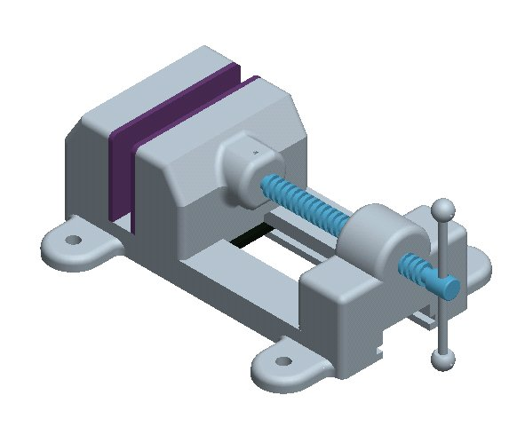
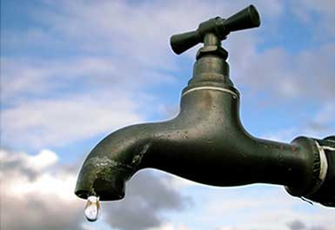
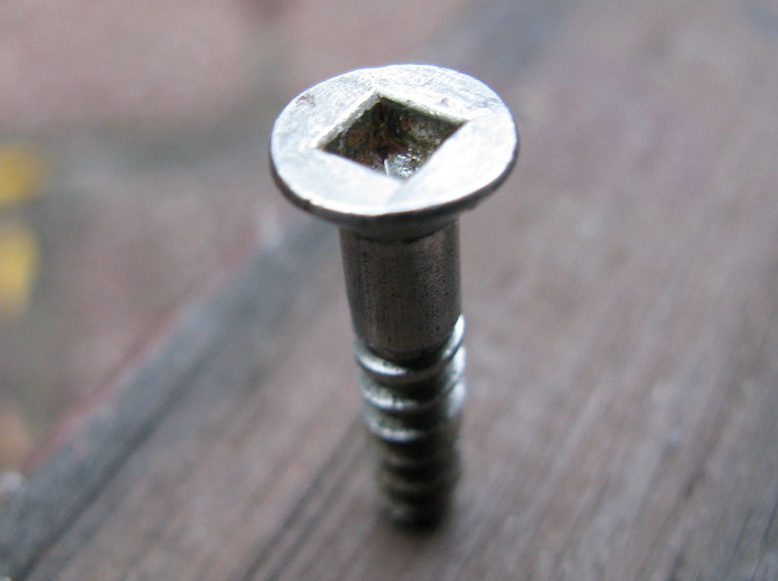
6. Helical Link
The guided part can undergo helical motion.
(In other words, it twists and moves forward at the same time, like a screw.)

Slide 22
Total of 24 possible types of link (but not all of them are used)
Type of Link (example) | Direct vs. indirect | Rigid vs. Flexible | Permanent vs. Removable | Complete vs. partial
Fixed Links (glue, nail, weld) | Indirect Direct | Rigid (flexible) | Permanent Removable | Complete Never partial!
Rotating Links (doorknob, scissors) | Indirect (Rarely direct) | Rigid (flexible) | Permanent (Removable) | Partial Never Complete!
Sliding Link (sliding door, drawer) | Usually Indirect (Rarely direct) | Rigid (flexible) | Permanent Or Removable | Partial Never Complete!
Sliding/Rotating Link (latch) | Indirect (Rarely Direct) | Rigid (flexible) | Permanent or Removable | Partial Never Complete!
Spherical Link (Joysticks, ball joints) | Direct (Rarely Indirect) | Rigid (flexible) | Permanent (Removable) | Partial Never Complete!
Helical Links (screws, faucets) | Direct (Rarely Indirect) | Rigid (flexible) | Removable (permanent) | Partial Never Complete!
Common
(Unusual)
Impossible

Slide 23
Helical
Direct, Rigid, Removable, Partial
Sample 2

Slide 24
Assignments on Links and Linking Functions.
Workbook page 207 to 210

Slide 25
Chapter 12.6
Complex Mechanical Functions

Slide 26
Systems and Functions
A system is a set of components that share the same function.
A complex mechanical function is the role played by a set of components in transferring motion inside a technical object.
There are two types of complex mechanical function:
1. Motion Transmission
2. Motion Transformation

Slide 27
Motion Transmission
Motion transmission occurs when motion is relayed from one part to another without changing the nature of the motion
In other words, if the first part rotates and the second part rotates it is transmission.
If the first part slides (translates) and the second part slides it is still transmission
But if the first part rotates and the second part slides, it’s not motion transmission (it’s transformation!)

Slide 28
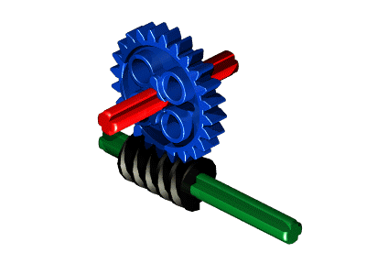
Examples of Motion Transmission
Gear 1
Friction Gears
Simple Gears
Belt and Pulley
Chain & Sprocket
Worm and Gear
Gear 2
Pulley 1
Pulley 2

Slide 29
Notice
All the transmission systems shown on the previous slide changed a rotation in one part into a rotation in another part.
Rotation → Rotation = Transmission
Although none of the systems illustrated this, the following would also be true:
Translation → Translation = Transmission

Slide 30
Speed Change in Transmission
One of the useful things about motion transmission is that it can change the speed of a rotation.
In general, the larger wheels in transmission systems move slower, the smaller wheels move faster.
Larger/more teeth on the driver or smaller/less teeth on driven component causes a speed increase.

Slide 31
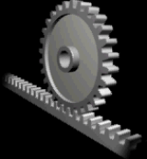
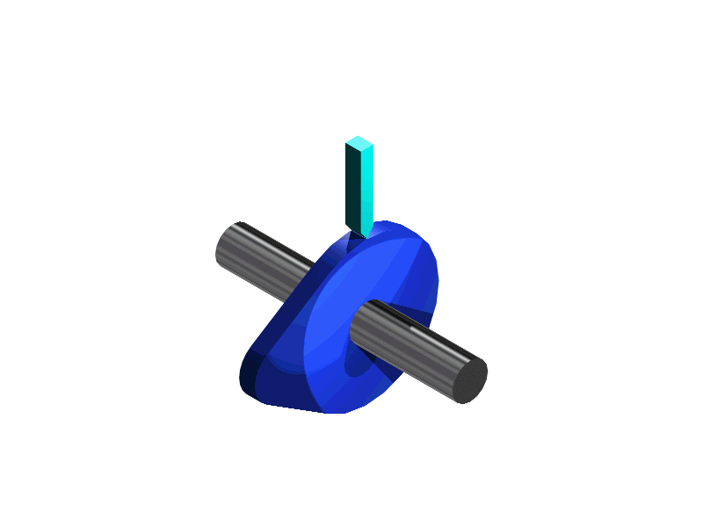
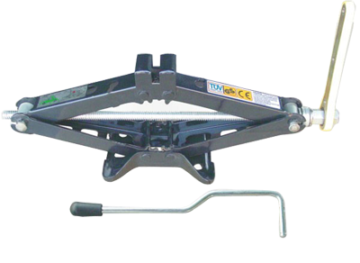
Motion Transformation
Crank and Slider
Rack and Pinion
Cam and Follower
Screw Gear

Slide 32
The motion transformation systems shown changed the nature of the motion from rotation to translation.
Rotation → Translation = Transformation
Translation → Rotation = Transformation

Slide 33
Assignments on Complex Mechanical Functions
Read pages 389 to 398 in your text book.
Pages 211 to 218.
Reminders:
Test soon. See blackboard for the date and record it in your agenda.
Also, all pages in the purple “technology” section of your workbook (up to page 218) will be due soon. Dates will be put on blackboard.

Slide 34
Video Examples
Gears
Pulleys
Worm Gear Speed Reducer (with belt and pulley and chain & sprocket attachments)
Rack & Pinion with Slider-crank
A Camshaft (Cams and followers)
Camshaft operating a valve (like a car engine)

Slide 35
Electricity
Electricity comes from the flow of electrons.
Electrons are the negative particles in atoms.
Electrons flow through conductors, such as the metal in wires.
An electric current is the orderly flow of negatively charged electrons.

Slide 36
Two types of Electric Current
Wire
–
–
–
–
Direct Current (DC) is the kind that comes from a battery. The electrical systems in your car use Direct Current. In Direct Current all the electrons move in the same direction all the time.
Wire
–
–
–
–
–
Alternating Current (AC) is the kind that comes from a generator. The electrical systems in your house use AC. In Alternating Current the electrons move back and forth many times per second (60 Hz in North America).

Slide 37
Parts of an Electric Circuit
Power Supply: The component that produces the electric current in a circuit.
This can be a battery, a generator, a solar panel, or similar device.
Conductors: Transmits the electrical current from one part of the circuit to another.
These are usually wires or metal strips.
Insulation: Blocks an electrical current.
The coating on wires, or the plastic caps on joined wires.

Slide 38
Load: Transforms electrical energy into another type of energy
Examples include light bulbs, heaters, motors, etc.
Controls: The switches and devices that control the circuit.
Push button switches, dimmer switches, rocker switches, magnetic switches, etc.
Protection: The components that automatically interrupt the flow of current in an emergency.
Examples include fuses and circuit breakers

Slide 39
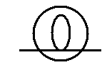
Symbols of Electrical Components (for use in circuit diagrams)
Power Supplies:
Conductor wires:
Loads:
Controls:
Direct Current (battery) Alternating Current (generator)
Wires are drawn as straight lines, bends are simplified as right angles
Light bulb or lamp Resistor or heater
Switch, Open (off) Switch, closed (on)

Slide 40
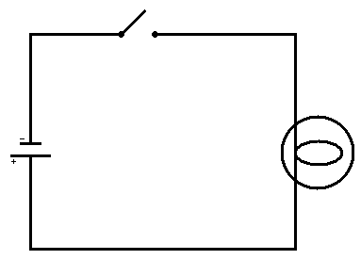
Simple Circuit Diagram
Switch
(drawn in open or OFF position) Control
Power Supply
(Battery)
Light bulb
Load for Energy transformation
Wires
Conductors

Slide 41
Transmission or Transformation?
Crank
Guide
Slider
Guide
Hint:
Answer: Transformation
Unidirectional Rotation is transformed into bidirectional translation
(turning into sliding)

Slide 42
Transmission or Transformation?
Pulley 1
Pulley 2
Hint:
Answer: Transmission
Unidirectional Rotation is transmitted to another wheel that does the same
(turning to turning)

Slide 43
The Manufacturing Process
Measure (identify the size and/or position on the material) and Mark (trace lines or mark the reference points on material) the parts.
Machine (forming parts into shape with equipment) the parts. (Saw, drill, shear, bend, forge, mould, etc.).
Assemble (stamp, nail, glue, rivet, weld, etc.) and Finish (polish, stain, paint, varnish, etc.) the technical object.

Slide 44
Measuring Wood Before Cutting
Calculate the length you need the piece of wood to be
Measure that distance from the “clean” end of the wood. “Measure twice, cut once.”
Mark the wood.
Draw a line across the wood using a square.
Put an “X” on the side of the wood you didn’t measure... The “scrap” side

Slide 45
Tips for cutting wood.
5. Cut on the “scrap” side
Place the saw so that the edge of the blade is exactly on your line, and the width of the blade is on the scrap side.
4. Put an X on the “scrap” side,
Opposite the side you measured, so you don’t accidentally cut the wrong side.
X
3. Extend the mark across the wood
Use a square to get the line straight.
SAW
2. Mark the measurement
Use a pencil to make a small mark.
1. “Measure twice, cut once”
Make sure that you have taken the measurement of your wood carefully!

Slide 46
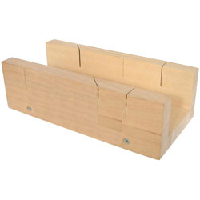
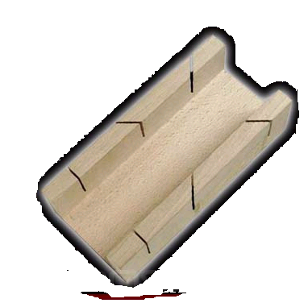
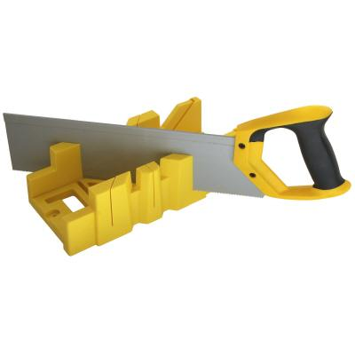
Using a Mitre Box to Cut Wood
A mitre box can help you make a square cut on a piece of wood.
The type of saw used with a mitre box is called a back saw.

Slide 47
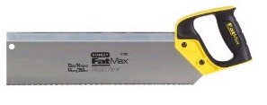
Using A Mitre box
Support the lip of the mitre box against the edge of the bench.
Line up the piece of wood to be cut against the far side of the mitre box
Cut away from yourself
Mitre Box
Workbench

