Slide 1
3.2 Graphing Exponential Functions
Chapter 3: Exponential Functions and Logarithms

Slide 2
Exponential Functions
An exponential function increases or decreases quickly
General form: $y=ac^{bx}$
Increases if c>1
Decreases if 0<c<1

Slide 3
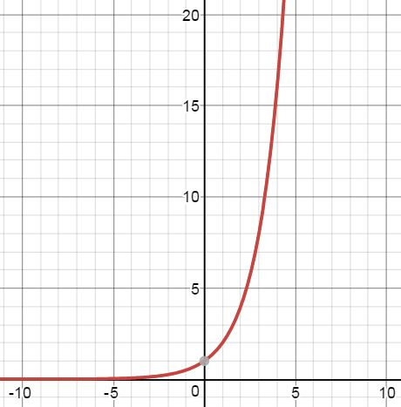
c>1
x | y=2^{x}
-3 | 0.125
-2 | 0.25
-1 | 0.5
0 | 1
1 | 2
2 | 4
3 | 8
4 | 16
5 | 32
Near zero for negative x, initial value at x=0,
Increases quickly for positive x

Slide 4
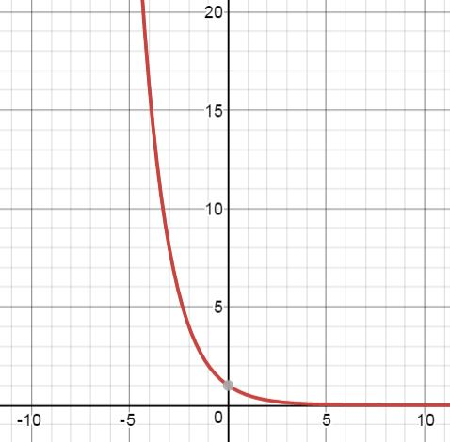
0<c<1
x | y=(1/2)^{x}
-5 | 32
-4 | 16
-3 | 8
-2 | 4
-1 | 2
0 | 1
1 | 0.5
2 | 0.25
3 | 0.125
Decreases quickly for negative x, initial value
at x=0, near zero for positive x

Slide 5
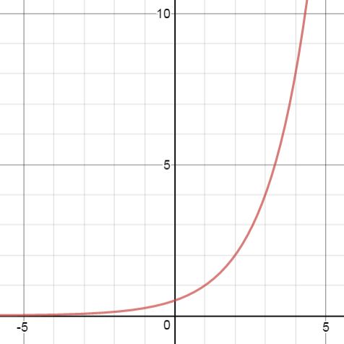
c>1, a≠0
x | y=0.5(2^{x})
-3 | 0.0625
-2 | 0.125
-1 | 0.25
0 | 0.5
1 | 1
2 | 2
3 | 4
4 | 8
5 | 16
Near zero for negative x, initial value at x=0
(read from graph), increases quickly for positive x

Slide 6
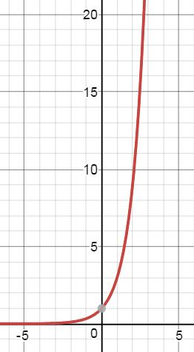
What is the rule? (a=1)

Slide 7
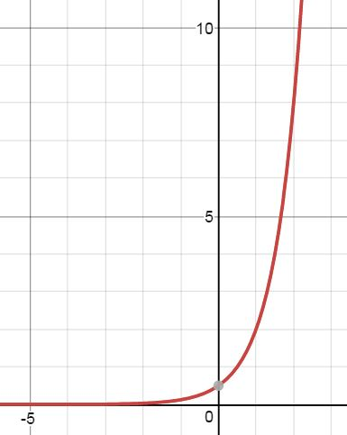
What is the rule? (a≠1)

