Slide 1
5.04 Types of Probability
Unit 5 Probability

Slide 2
“Additional”
Types of Probability

Slide 3

Formula
$$P\left(A∪B\right)=P\left(A\right)+P\left(B\right)$$

Slide 4





Example 1
A single 6-sided die is rolled. What is the probability of rolling a 2 or a 5?
Event A: Rolling a 2
Event B: Rolling a 5
$$P\left(A\right)=\frac{1}{6}$$
$$P\left(B\right)=\frac{1}{6}$$
$$P\left(A∪B\right)=P\left(A\right)+P\left(B\right)$$
$$\frac{1}{6}+\frac{1}{6}$$
$$=\frac{2}{6}$$
$$=\frac{1}{3}$$
$$P\left(A∪B\right)=$$

Slide 5
Conditional Probability
The probability that an event will happen given that another event is known to have already taken place.
$$P\left(B | A\right)=\frac{P\left(A∩B\right)}{P\left(A\right)}$$

Slide 6
Example 1
A 6-sided die is rolled and the top face is observed.
Event A: Obtaining an odd number
Event B: Obtaining a number greater than 2
$$Ω$$
$$A$$
$$B$$

Slide 7
-What is the probability of obtaining an odd number? -What is the probability of obtaining a number greater than 2? -What is the probability of obtaining a number greater than 2 given that it is an odd number?
$Ω=\left\{1, 2, 3, 4, 5, 6\right\}$
$$A$$
$$B$$
$$3$$
$$4$$
$$1$$
$$5$$
$$6$$
$$2$$

Slide 8
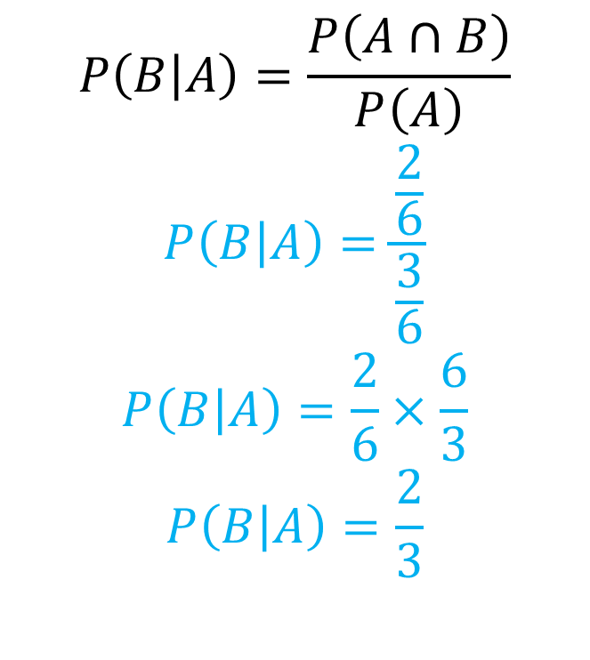

Manipulating the Formula
$←$use if given probabilities as decimals
$$P\left(B | A\right)=\frac{P\left(A∩B\right)}{P\left(A\right)}$$
$$P\left(B | A\right)=\frac{\frac{2}{6}}{\frac{3}{6}}$$
$$P\left(B | A\right)=\frac{2}{6}×\frac{6}{3}$$
$$P\left(B | A\right)=\frac{2}{3}$$
$$P\left(B | A\right)=\frac{2}{3}$$
$$P\left(B | A\right)=\frac{A∩B}{A}$$
use if getting values from $→$ a diagram

Slide 9
Example 2
A math teacher gave her class two tests. 62% of the class passed both tests and 80% of the class passed the first test. What percent of those who passed the first test also passed the second test?
Event A: A student passed the first test
Event B: A student passed the second test

Slide 10
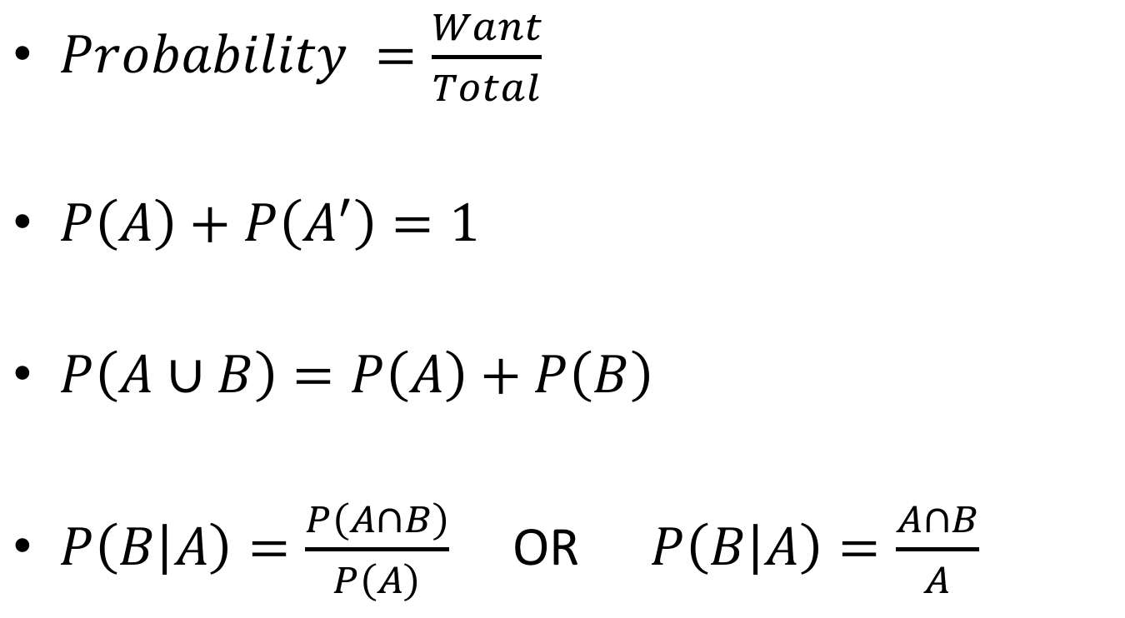

Summary of Formulas
Mutally Exclusive Events
$$A∩B=∅$$
or
$$P\left(A∩B\right)=0$$
$Probability =\frac{Want}{Total}$
$P\left(A\right)+P\left(A^{′}\right)=1$
$P\left(A∪B\right)=P\left(A\right)+P\left(B\right)$
$P\left(B | A\right)=\frac{P\left(A∩B\right)}{P\left(A\right)}$ OR $P\left(B | A\right)=\frac{A∩B}{A}$

