Slide 1
5.03 Organizers and Probability
Venn Diagrams and Contingency Tables

Slide 2
Filling in the Venn Diagram
Trial Run

Slide 3
Venn Diagrams
Used when outcomes being categorized by events
2 or 3 Events
$$Ω$$
$$A$$
$$B$$
$$C$$

Slide 4
35 Students Polled
A: Live on a Farm
B: Cheer for the Toronto Blue Jays
C: Own a Pet
FARM
JAYS
PET

Slide 5
35 Students Polled
16 students live on a farm
17 students cheer for the Jays
28 students cheer Jays or own a pet
3 students who live on a farm own a pet and cheer for the Jays
5 students cheer for the Jays and own a pet
11 Students live on a farm and cheer for the Jays
26 students own a pet or live on a farm

Slide 6
Turn statements into set builder notation
Step 2

Slide 7
35 Students Polled $$Ω=35$$
16 students live on a farm
17 students cheer for the Jays
28 students cheer Jays or own a pet
3 students who live on a farm own a pet and cheer for the Jays
5 students cheer for the Jays and own a pet
11 Students live on a farm and cheer for the Jays
26 students own a pet or live on a farm
$A=16$
$B=17$
$B∪C=28$
$A∩B∩C=3$
$B∩C=5$
$A∩B=11$
$A∪C=26$

Slide 8
Fill-in Venn Diagram Start with “and” s
Step 3

Slide 9
$$Ω=35$$
3
$A=16$
$B=17$
$B∪C=28$
$A∩B∩C=3$
$B∩C=5$
$A∩B=11$
$A∪C=26$

Slide 10

$$Ω=35$$
8
3
2
$A=16$
$B=17$
$B∪C=28$
$A∩B∩C=3$
$B∩C=5$
$A∩B=11$
$A∪C=26$

Slide 11

$$Ω=35$$
8
4
3
2
$A=16$
$B=17$
$B∪C=28$
$A∩B∩C=3$
$B∩C=5$
$A∩B=11$
$A∪C=26$

Slide 12

$$Ω=35$$
8
4
3
2
$A=16$
$B=17$
$B∪C=28$
$A∩B∩C=3$
$B∩C=5$
$A∩B=11$
$A∪C=26$

Slide 13


$$Ω=35$$
8
4
3
2
$A=16$
$B=17$
$B∪C=28$
$A∩B∩C=3$
$B∩C=5$
$A∩B=11$
$A∪C=26$
$$28−4−8−3−2=11$$
11 LEFT in two

Slide 14
$$Ω=35$$
8
4
3
2
$A=16$
$B=17$
$B∪C=28$
$A∩B∩C=3$
$B∩C=5$
$A∩B=11$
$A∪C=26$

Slide 15


$$Ω=35$$
8
4
3
2
$A=16$
$B=17$
$B∪C=28$
$A∩B∩C=3$
$B∩C=5$
$A∩B=11$
$A∪C=26$
$$26−8−3−2=13$$
13 LEFT in three

Slide 16
$$Ω=35$$
2
8
4
3
2
$A=16$
$B=17$
$B∪C=28$
$A∩B∩C=3$
$B∩C=5$
$A∩B=11$
$A∪C=26$
11 LEFT in two
13 LEFT in three

Slide 17
$$Ω=35$$
2
8
4
3
3
2
$A=16$
$B=17$
$B∪C=28$
$A∩B∩C=3$
$B∩C=5$
$A∩B=11$
$A∪C=26$

Slide 18

$$Ω=35$$
2
8
4
3
3
2
$B=17$
$B∪C=28$
$A∩B∩C=3$
$B∩C=5$
$A∩B=11$
$A∪C=26$
8

Slide 19
$$Ω=35$$
2
8
4
3
3
2
8
5

Slide 20
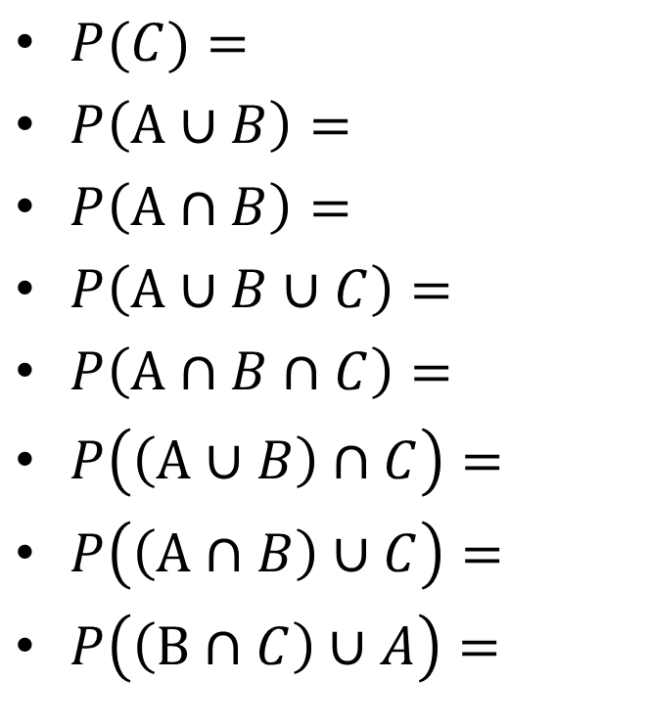
Probabilities
$P(C)=$
$P\left(A∪B\right)=$
$P\left(A∩B\right)=$
$P\left(A∪B∪C\right)=$
$P\left(A∩B∩C\right)=$
$P\left(\left(A∪B\right)∩C\right)=$
$P\left(\left(A∩B\right)∪C\right)=$
$P\left(\left(B∩C\right)∪A\right)=$

Slide 21
$$Ω=35$$
2
8
4
3
3
2
$$P(C)$$
8
5

Slide 22
$$Ω=35$$
2
8
4
3
3
2
$$P(C)$$
8
5

Slide 23
$$Ω=35$$
2
8
4
3
3
2
$$P\left(A∪B\right)$$
8
5

Slide 24
$$Ω=35$$
2
8
4
3
3
2
$$P\left(A∪B\right)$$
8
5

Slide 25
$$Ω=35$$
2
8
4
3
3
2
$$P\left(A∩B\right)$$
8
5

Slide 26
$$Ω=35$$
2
8
4
3
3
2
$$P\left(A∩B\right)$$
8
5

Slide 27

$$Ω=35$$
2
8
4
3
3
2
$$P\left(A∪B∪C\right)$$
8
5

Slide 28

$$Ω=35$$
2
8
4
3
3
2
$$P\left(A∩B∩C\right)$$
8
5

Slide 29

$$Ω=35$$
2
8
4
3
3
2
$$P\left(\left(A∪B\right)∩C\right)$$
8
5

Slide 30

$$Ω=35$$
2
8
4
3
3
2
$$P\left(\left(A∩B\right)∪C\right)$$
8
5

Slide 31

$$Ω=35$$
2
8
4
3
3
2
$$P\left(\left(B∩C\right)∪A\right)$$
8
5

Slide 32

Probabilities
$P(C)=$
$P\left(A∪B\right)=$
$P\left(A∩B\right)=$
$P\left(A∪B∪C\right)=$
$P\left(A∩B∩C\right)=$
$P\left(\left(A∪B\right)∩C\right)=$
$P\left(\left(A∩B\right)∪C\right)=$
$P\left(\left(B∩C\right)∪A\right)=$
$\frac{16}{35}$
$\frac{22}{35}$
$\frac{11}{35}$
$\frac{30}{35}$
$\frac{3}{35}$
$\frac{8}{35}$
$\frac{24}{35}$
$\frac{18}{35}$

Slide 33
Contingency Tables
Used when the pieces of information fall into two separate categories who each have subcategories.
Category 1 Category 2 | ^{C1}S1 | ^{C1}S2 | TOTAL
^{C2}S1
^{C2}S2
TOTAL

Slide 34
Contingency Tables
James has a movie collection. He is interested in both Blu-Rays and DVDs. He is currently organizing his Thriller and Action movies.
He finds that he has
63 thrillers.
The probability that a movie he draws from the pile is a thriller is $42\%$
When he has the movies sorted, the probability that he pulls a DVD from the pile of Action movies is $\frac{14}{29}$
Further sorting shows that when he reaches into a Blu-Ray pile, the probability that he will pull out an action movie is $0.61644$
BR/DVD THR/ACT | BR | DVD | TOTAL
THR
ACT
TOTAL

Slide 35
Contingency Tables
James has a movie collection. He is interested in both Blu-Rays and DVDs. He is currently organizing his Thriller and Action movies.
He finds that he has
63 thrillers.
The probability that a movie he draws from the pile is a thriller is $42\%$
When he has the movies sorted, the probability that he pulls a DVD from the pile of Action movies is $\frac{14}{29}$
Further sorting shows that when he reaches into a Blu-Ray pile, the probability that he will pull out an action movie is $0.61644$
BR/DVD THR/ACT | BR | DVD | TOTAL
THR | 28 | 35 | 63
ACT | 45 | 42 | 87
TOTAL | 73 | 77 | 150

Slide 36
Practice
Handout 5.03
Due TOMORROW
Pg 101 # 1
TEST Friday April 22nd

