Slide 1
5.00B Review Continued
Unit 5 Probability

Slide 2
Probability Line and Words

Slide 3
Try It: Where will the statement sit on the probability line?
The sun will rise tomorrow

Slide 4
Try It: Where will the statement sit on the probability line?
A child will not have to learn math in school

Slide 5
Try It: Where will the statement sit on the probability line?
If I flip a coin it will land heads up

Slide 6
Try It: Where will the statement sit on the probability line?
Choosing a red ball from a bag with 1 red ball and 3 green balls

Slide 7
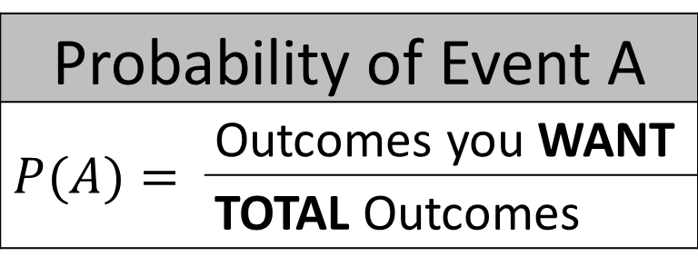
Probability Formula
Probability of Event A
$$P(A)=$$ | Outcomes you WANT
 | TOTAL Outcomes

Slide 8
More Than One Possible Outcome
What is the probability of rolling the sum of 2 or the sum of 3?
$A=rolling sum of 2$
$B=rolling sum of 3$
$$P\left(A or B\right)=P\left(A\right)+P\left(B\right)$$
$$P\left(A or B\right)=\frac{1}{36}+\frac{2}{36}$$
$$P\left(A or B\right)=\frac{3}{36}$$
$=\frac{1}{12}$

Slide 9
One thing AND THEN another
What is the probability of rolling a 2 and then a 3
$A=rolling a 2 on the first dice$
$B=rolling a 3 on the second dice$
$$P\left(A and then B\right)=P\left(A\right)×P(B)$$
$$P\left(A and then B\right)=\frac{1}{6}×\frac{1}{6}$$
$$P\left(A and then B\right)=\frac{1}{36}$$

Slide 10
Try It $$P\left(A and then B\right)=P\left(A\right)×P(B)$$
Given a bag with all of the letters of the alphabet in it,
What is the probability of picking out a vowel and then a ‘C’ without putting the letter back
$$A=picking a vowel from a,e, i, o, u,y$$
$$B=picking a ′C′$$
$$P\left(A and then B\right)=P\left(A\right)×P\left(B\right)$$
$$P\left(A and then B\right)=\frac{6}{26}×\frac{1}{25}$$
$$P\left(A and then B\right)=\frac{6}{650}$$

Slide 11
One thing AND THEN another with various ways to obtain
What is the probability of rolling a 2 and a 3
$$P\left(2 and 3\right)=P\left(2_{1},3_{2}\right)+P\left(3_{1},2_{2}\right)$$
$$P\left(2 and 3\right)=\left(P\left(2_{1} \right)×P\left(3_{2}\right)\right)+\left(P\left(3_{1}\right)×P\left(2_{2}\right)\right)$$
$$P\left(2 and 3\right)=\left(\frac{1}{6}×\frac{1}{6}\right)+\left(\frac{1}{6}×\frac{1}{6}\right)$$
$$P\left(2 and 3\right)=\frac{1}{36}+\frac{1}{36}$$
$$P\left(2 and 3\right)=\frac{2}{36}$$
$$P\left(2 and 3\right)=\frac{1}{18}$$

Slide 12
Try It
Given a bag with all of the letters of the alphabet in it,
What is the probability of picking out a vowel and a ‘C’ without putting the first letter back
$$P\left(vowel and ′C′\right)=P\left(v,C\right)+P\left(C,v\right)$$
$$P\left(vowel and ′C′\right)=\left(P\left(v\right)×P\left(C\right)\right)+\left(P\left(C\right)×P\left(v\right)\right)$$
$$P\left(vowel and ′C′\right)=\left(\frac{6}{26}×\frac{1}{25}\right)+\left(\frac{1}{26}×\frac{6}{25}\right)$$
$$P\left(vowel and ′C′\right)=\left(\frac{6}{650}\right)+\left(\frac{6}{650}\right)$$
$$=\frac{12}{650}$$

Slide 13
Complement
The complement of an event is collection of outcomes that are NOT that event.
If $A=landing on blue$ $A^{′}=landing on NOT blue$
$P\left(A\right)+P\left(A^{′}\right)=1$

Slide 14
Why this helps
Sometimes it’s easier to calculate the probability of a complementary event and work backwards.

Slide 15
Example
You are rolling two dice.
What is the probability that the two faces that land up have different numbers on them?
$$A= landing on two different numbers$$
Sample Space:
$Ω_{A}=\left\{\begin{aligned}1−2, 1−3, 1−4, 1−5, 1−6… \\ … 2−1, 2−3, 2−4, 2−5, 2−6, … \\ …3−1, 3−2, 3−4, 3−5, 3−6… \\ … 4−1, 4−2, 4−3, 4−5, 4−6… \\ …5−1, 5−2, 5−3, 5−4, 5−6… \\ … 6−1, 6−2, 6−3, 6−4, 6−5\end{aligned}\right\}$
$$A^{′}= landing on same number$$
$Ω_{A^{′}}=\left\{1−1, 2−2, 3−3, 4−4, 5−5, 6−6, \right\}$

Slide 16
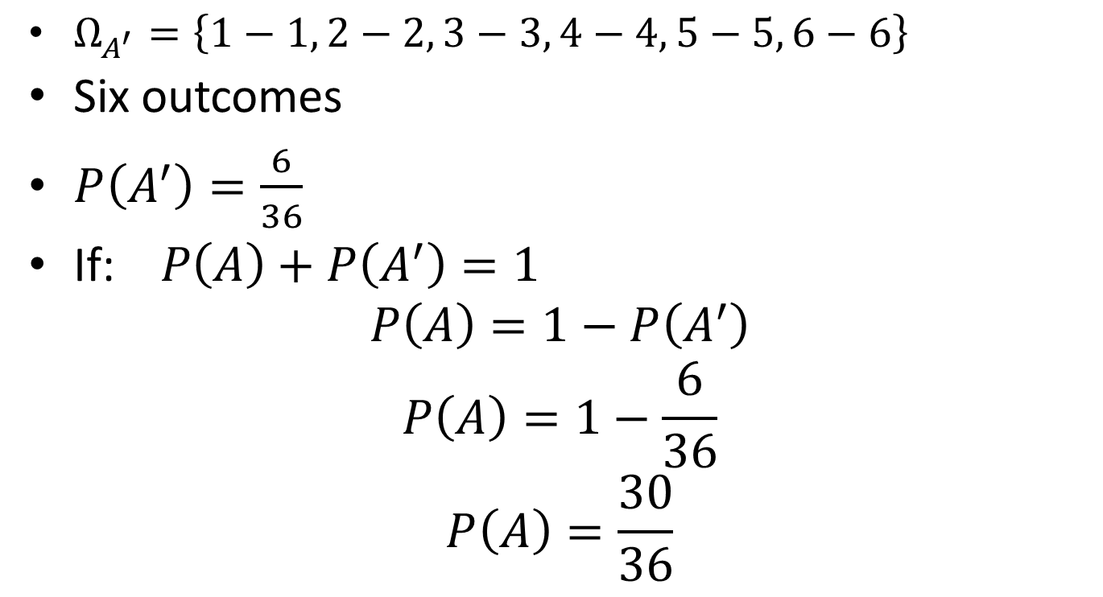
Example
$Ω_{A^{′}}=\left\{1−1, 2−2, 3−3, 4−4, 5−5, 6−6\right\}$
Six outcomes
$P\left(A^{′}\right)=\frac{6}{36}$
If:$P\left(A\right)+P\left(A^{′}\right)=1$
$$P\left(A\right)=1−P\left(A^{′}\right)$$
$$P\left(A\right)=1−\frac{6}{36}$$
$$P\left(A\right)=\frac{30}{36}$$

