Slide 1
Order of Operations

Slide 2
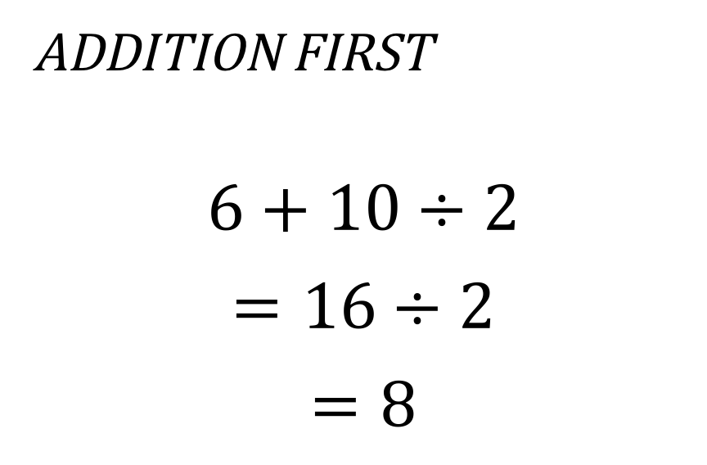
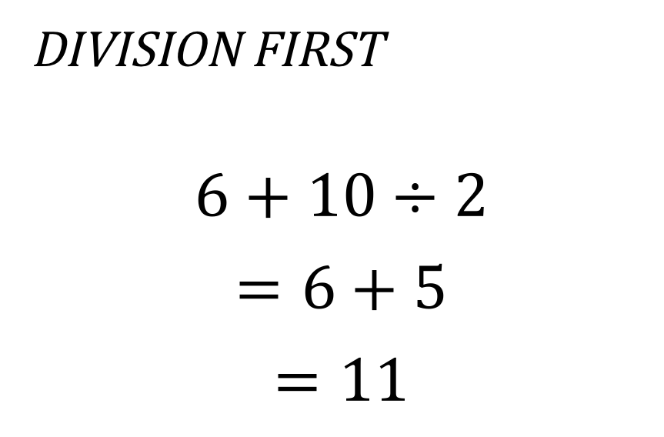
Which is it?
Addition First
$$6+10÷2$$
$$=16÷2$$
$$=8$$
Division First
$$6+10÷2$$
$$=6+5$$
$$=11$$

Slide 3
BEDMAS
Brackets
Exponents
Division and Multiplication (from left to right)
Addition and Subtraction (from left to right)

Slide 4
Why BEDMAS?
Standardized understandings and processes make communication of ideas easier.

Slide 5
Example
Simplify
$$4−4^{3}÷8+\left(2∙6÷4\right)+2$$

Slide 6
Worksheet
Complete the worksheet (both sides!) and turn it in tomorrow.

Slide 7
Extension
Find every number between 1 and 20 using only four 4s and any operation (ex: +, -, $×$, $÷, \sqrt{}, etc)$.
Ex. $\sqrt{4}+\sqrt{4}+\frac{4}{4}=5$
(check your answers using bedmas!)

