Slide 1
Simplifying Algebraic Expressions

Slide 2
Homework Answers
Check your own homework
Correct any mistakes – make sure you understand!

Slide 3
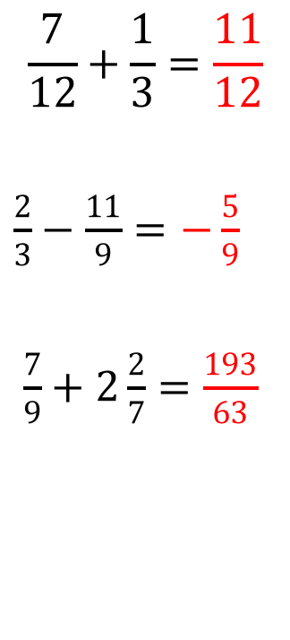


Try It! Solutions
Change from mixed fractions to improper fractions
Solve
Solve
$$\frac{7}{12}+\frac{1}{3}=\frac{11}{12}$$
$\frac{2}{3}−\frac{11}{9}=$ $−\frac{5}{9}$
$\frac{7}{9}+2\frac{2}{7}=$ $\frac{193}{63}$
$$1\frac{1}{5}−\frac{4}{3}=−\frac{2}{15}$$
$\frac{2}{5}+\frac{4}{5}=$ $\frac{6}{5}$
$−\frac{9}{11}−\frac{1}{3}=$ $−\frac{38}{33}$
$2\frac{3}{8}=$ $\frac{19}{8}$
$4\frac{5}{9}=$ $\frac{41}{9}$
$−7\frac{2}{3}=$ $−\frac{23}{3}$

Slide 4
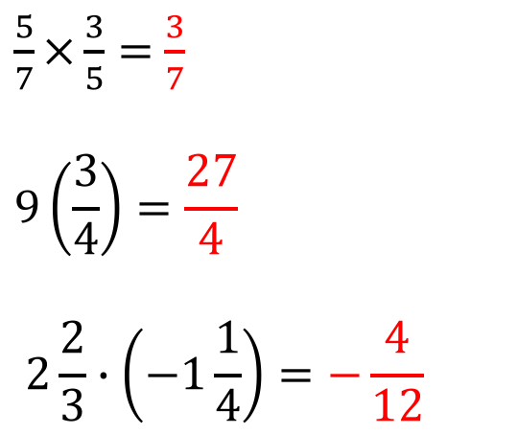
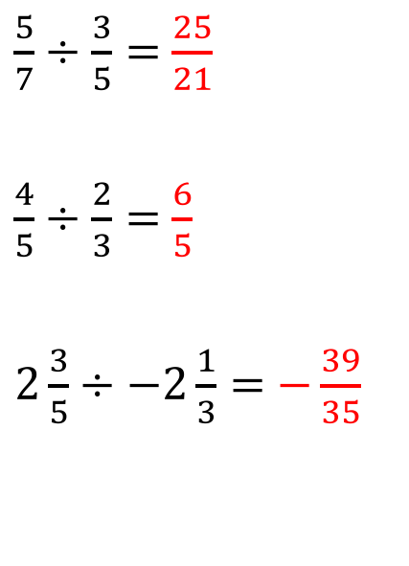
Try It! Solutions
Solve
Solve
$\frac{5}{7}÷\frac{3}{5}=$ $\frac{25}{21}$
$\frac{4}{5}÷\frac{2}{3}=$ $\frac{6}{5}$
$2\frac{3}{5}÷−2\frac{1}{3}=$ $−\frac{39}{35}$
$\frac{5}{7}×\frac{3}{5}=$ $\frac{3}{7}$
$$9\left(\frac{3}{4}\right)=\frac{27}{4}$$
$$2\frac{2}{3}∙\left(−1\frac{1}{4}\right)=−\frac{4}{12}$$

Slide 5
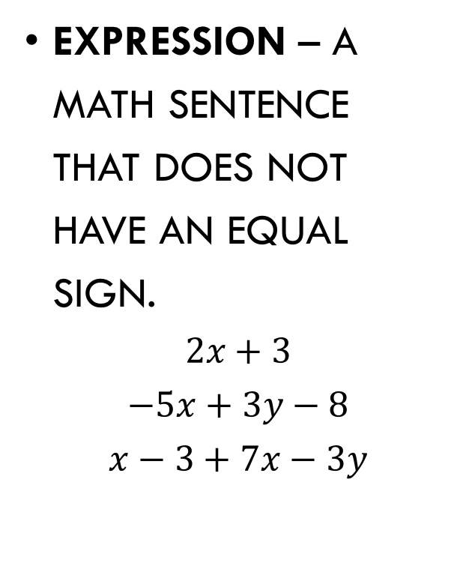
Simplifying Algebraic expressions
Expression – A math sentence that does not have an equal sign.
$$2x+3$$
$$−5x+3y−8$$
$$x−3+7x−3y$$
Equation – A math sentence that contains an equal sign.
$$2x+3=24$$
$$−5x+3y−8=4x+2$$
$$x−3+7x−3y=9$$
Terms – Each part of an expression. The sign in front of each term goes with that term. $2x+3−4y−8$
The terms are:

Slide 6
Simplifying Algebraic expressions
Like terms – terms that have identical variable parts and identical exponents
$$−6x+3+5x^{2}−9+2x$$
Like terms are:
coefficient – the number in front of a variable term. If there is no number, the coefficient is one.
$$5x−2+y−8x$$
The coefficients are:
constant – a term that has a number, but no variable. $5x+12+3y−5$
The constants are:

Slide 7


Simplifying Algebraic expressions
Combine Like terms – you can add or subtract terms that are alike
$$9y−x+2y+5$$
example
$$4x^{2}−2x+3+x^{2}−4$$
Example
$6x+3xy−x−8$

Slide 8


Simplifying Algebraic expressions
Distribute first always multiply/divide before combining like terms
$$5\left(2y−3\right)−4y$$
example
$$\frac{6x^{2}−4x}{2}+2x^{2}−5x+9$$
Example
$$2x\left(x−y\right)−xy$$

Slide 9
Worksheet
Complete simplifying algebraic expressions worksheet
Homework: What were the main mathematical concepts (ideas) discussed in class today?
(You should write in complete sentences and your response should be very detailed – at least 4 complete sentences.)

Slide 10
Jo Boaler video – brain growth
Video
Think/pair/share: how do the ideas presented in this video around brain growth relate to Grade 11 CST Math?

