Slide 1
Solving Algebraic equations

Slide 2
TIPS
Identify what kind of problem you have (type 1, 2, etc.) and use the examples as your guide.
Whatever you do to one side, you must do to the other side.
Your goal is to work backwards to get the variable (x, a, b, etc.) by itself.
Work vertically, and keep your equal signs aligned (keep it neat!)

Slide 3
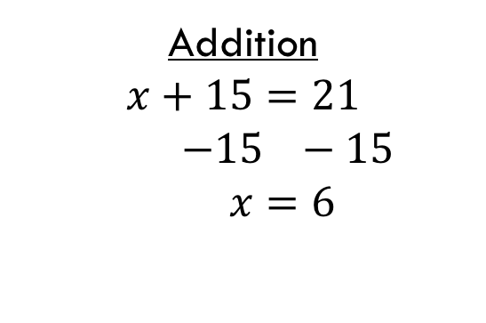
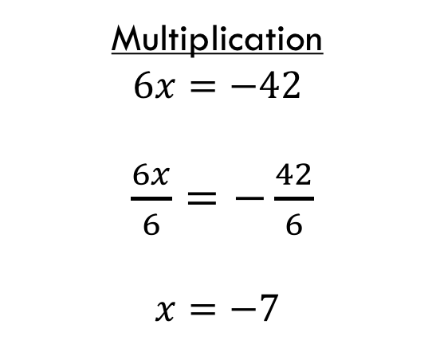
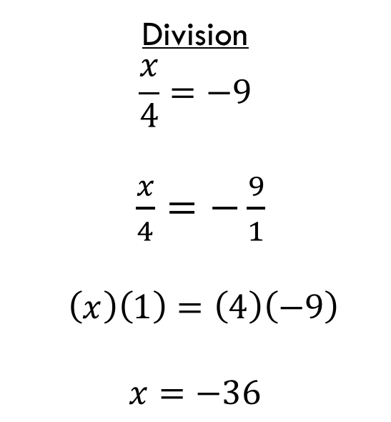
Type 1
1 step – just do the opposite
Subtraction
$$x−9=6$$
$+9 +9$
$$x=15$$
Multiplication
$$6x=−42$$
$\frac{6x}{6}=−\frac{42}{6}$
$$x=−7$$
Division
$$\frac{x}{4}=−9$$
$\frac{x}{4}=−\frac{9}{1}$
$$\left(x\right)\left(1\right)=\left(4\right)\left(−9\right)$$
$$x=−36$$
Addition
$$x+15=21$$
$−15 −15$
$$x=6$$

Slide 4

Type 2
Multiple steps - Always do the opposite of any addition or subtraction first, then do the inverse of any multiplication or division
$$5x−9=8$$
$$+9 +9$$
$5x=17$
$$\frac{5x}{5}=\frac{17}{5}$$
$x=\frac{17}{5} or 3.4$

Slide 5


Type 3
This equation type has variables on both sides of the equal sign. To solve, you must first gather like terms on each side of the equal sign (move variables to one side and constants to the other)
$$9−5x=9x+5$$
$$−9 −9$$
$−5x=9x−4$
$$−9x −9x$$
$$−14x=−4$$
$$\frac{−14x}{−14}=\frac{−4}{−14}$$
$$x=\frac{2}{7} or 0.29$$
$$3x+2=x−5$$
$$−2 −2$$
$3x=x−7$
$$−x −x$$
$$2x=−7$$
$$\frac{2x}{2}=−\frac{7}{2}$$
$x=−\frac{7}{2} or −3.5$

Slide 6
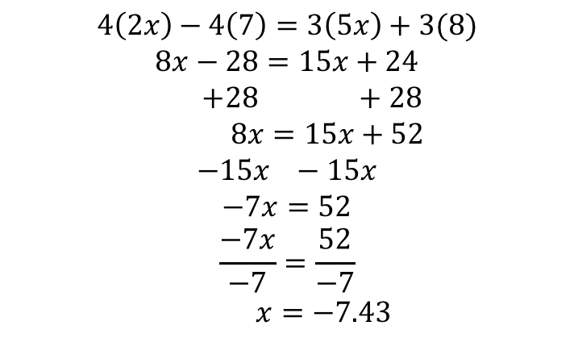
Type 4
This equation has one or more sets of brackets. Use the number on the outside of the brackets and multiply it by everything inside the brackets. Then proceed to solve like type 3 or type 2.
$$4\left(2x−7\right)=3(5x+8)$$
$$4\left(2x\right)−4\left(7\right)=3\left(5x\right)+3(8)$$
$$8x−28=15x+24$$
$+28 +28$
$8x=15x+52$
$$−15x −15x$$
$$−7x=52$$
$$\frac{−7x}{−7}=\frac{52}{−7}$$
$x=−7.43$

Slide 7
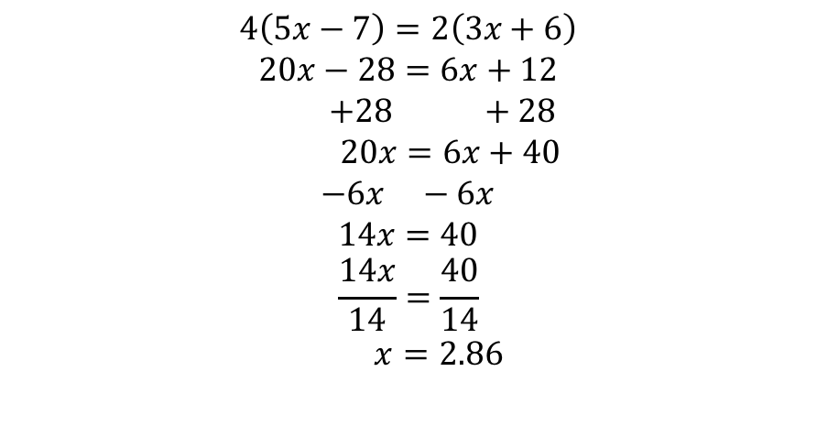
Type 5
This is make up of two fractions. We first cross multiply (multiply the denominator of the left by the numerator of the right, and vice versa). We place one result on the right of the equal sign and the other on the left. We then proceed to solve it like a type 2 or 3.
$$\frac{3x+6}{4}=\frac{5x−7}{2}$$
$$4\left(5x−7\right)=2\left(3x+6\right)$$
$$20x−28=6x+12$$
$$+28 +28$$
$$20x=6x+40$$
$$−6x −6x$$
$$14x=40$$
$$\frac{14x}{14}=\frac{40}{14}$$
$$x=2.86$$

Slide 8
Extension
Find every number between 1 and 20 using only four 4s and any operation (ex: +, -, $×$, $÷, \sqrt{}, etc)$.
Ex. $\sqrt{4}+\sqrt{4}+\frac{4}{4}=5$
(check your answers using bedmas!)

